Slide 1
Introduction to Powerapps
10.06.2022
Nithish Kalakonda

Slide 2
Contents
Introduction to Powerapps
Tasks Manager – Workshop
Importing a Powerapp

Slide 3
https://make.powerapps.com/
https://bit.ly/3MGcY13

Slide 4
What is power apps ?
PowerApps is a tool that allows you to create custom apps on Apple IOS/ Android versions
Apps can be accessed via mobile devices or via the browser
What sets PowerApps apart from other offerings is that while it can be used by developers, it can also be used by non-technical employees
Model driven and Canvas apps
Notes:
PowerApps ist ein Tool, mit dem Sie benutzerdefinierte Apps für Apple IOS/ Android-Versionen erstellen können.
Auf die Apps kann über mobile Geräte oder über den Browser zugegriffen werden
PowerApps unterscheidet sich von anderen Angeboten dadurch, dass es zwar von Entwicklern, aber auch von nichttechnischen Mitarbeitern genutzt werden kann

Slide 5
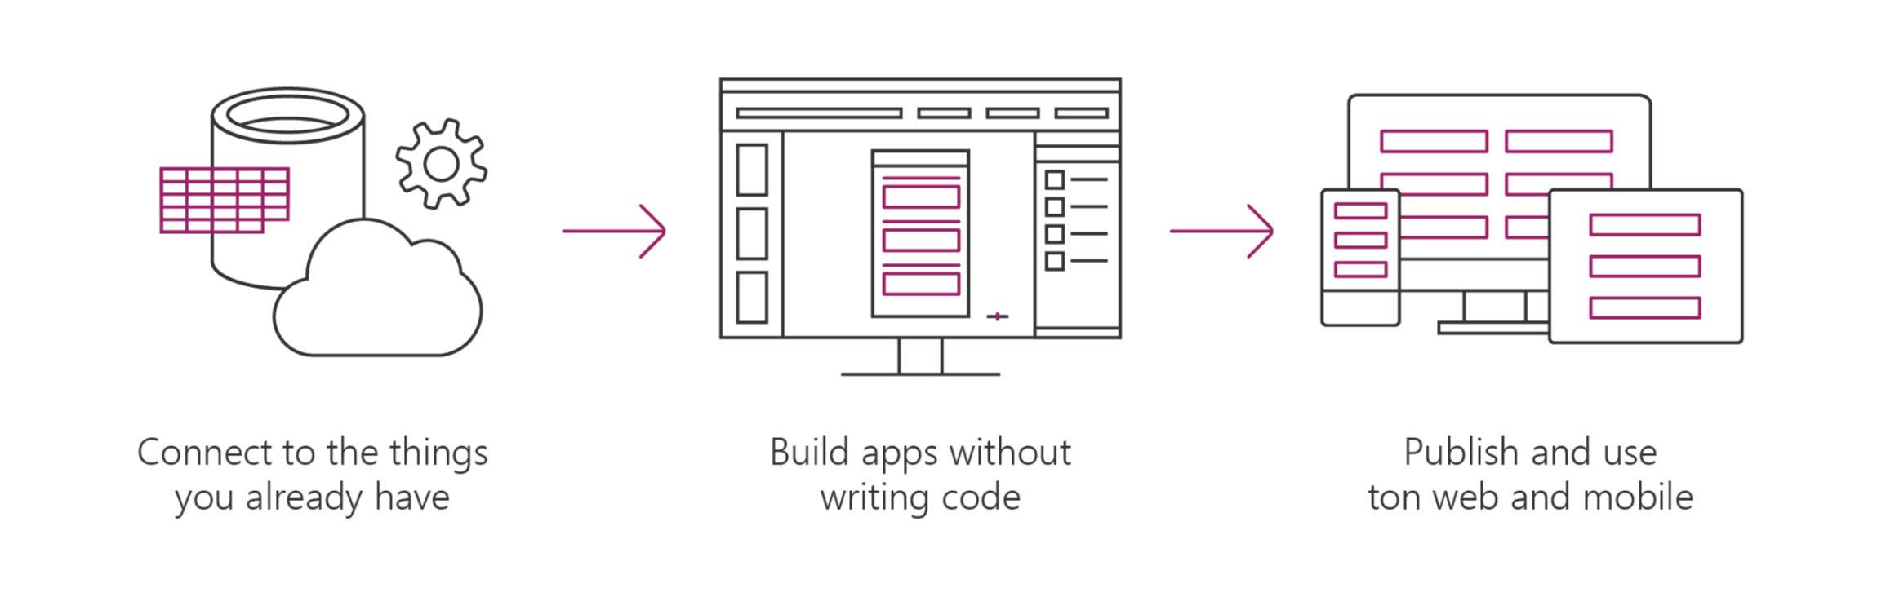
Canvas Apps help business-power-users to create and use custom business apps across platforms using Excel and PowerPoint skills
Connect to data & systems you’re already using easily
Create apps, forms, and workflows without writing code
Use apps on any device – both web and mobile
Notes:
Canvas App ist ein AppModul, mit dem Benutzer aufgabenspezifische Anwendungen mit flexibler Planung und entwickeln können.

Slide 6
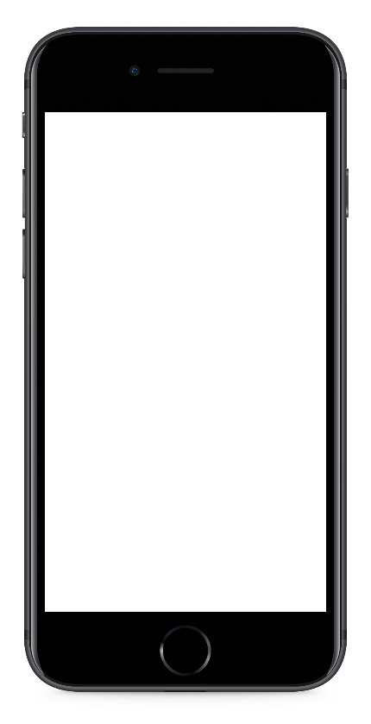
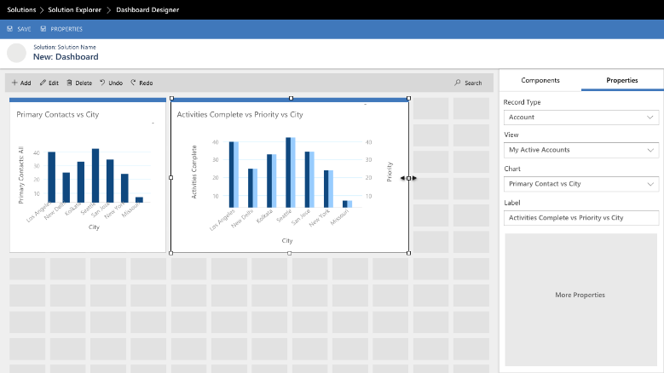
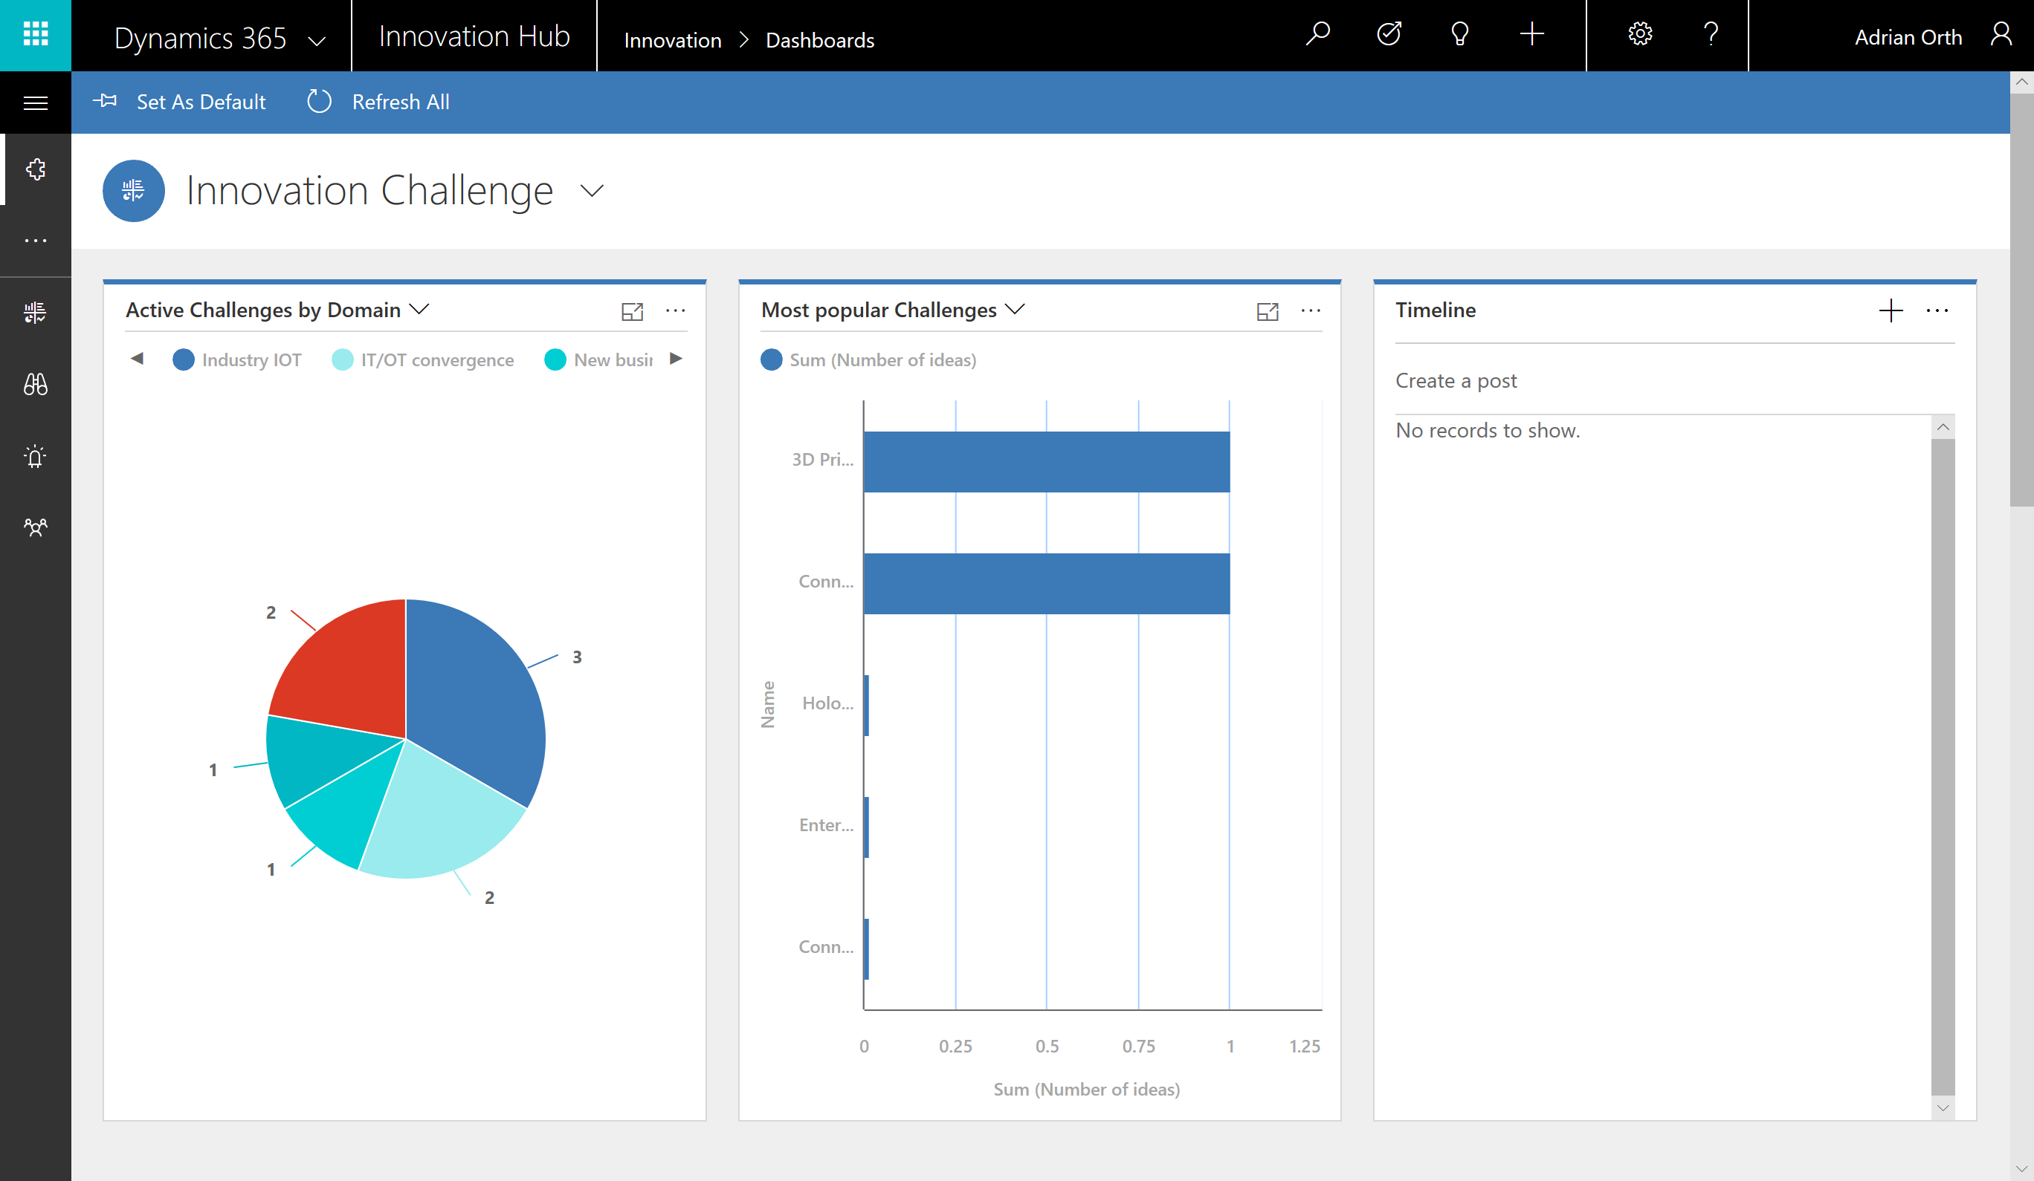
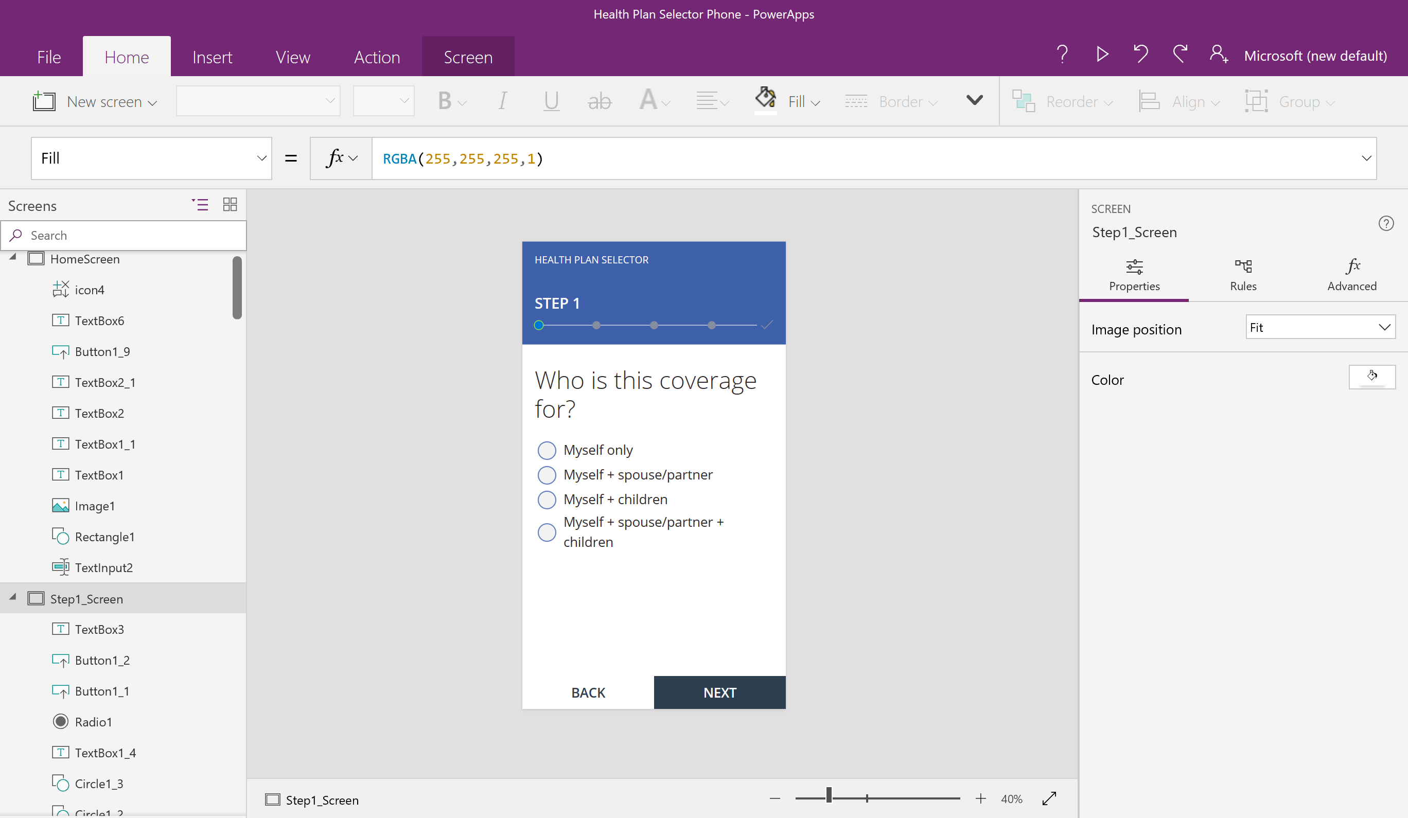
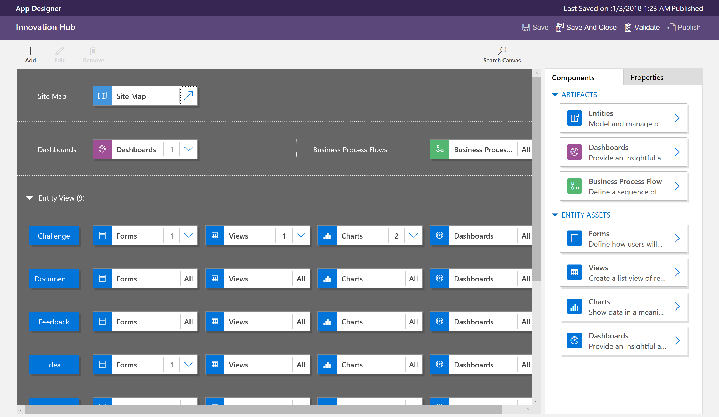

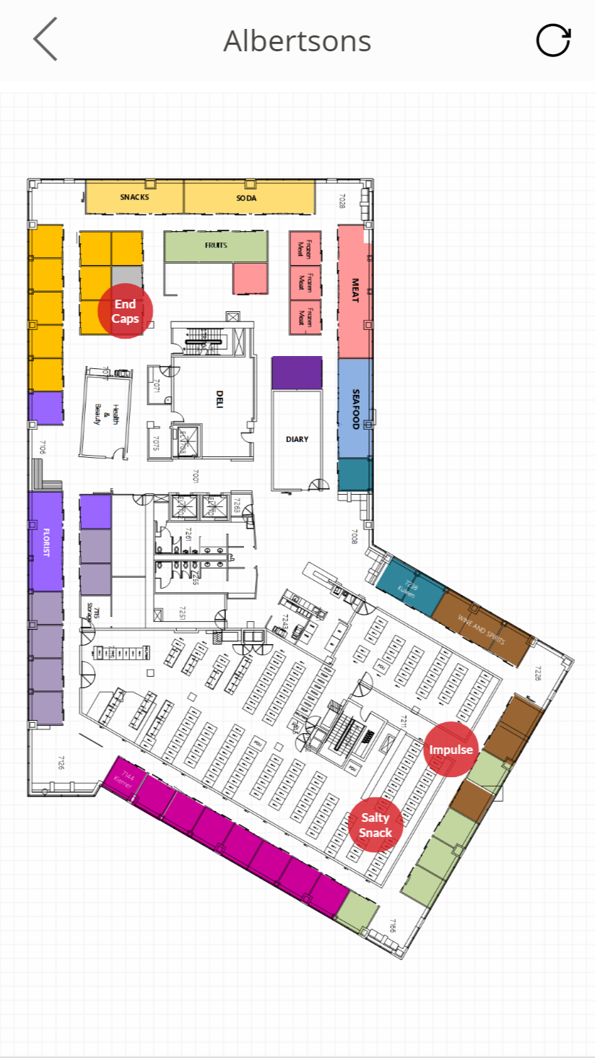
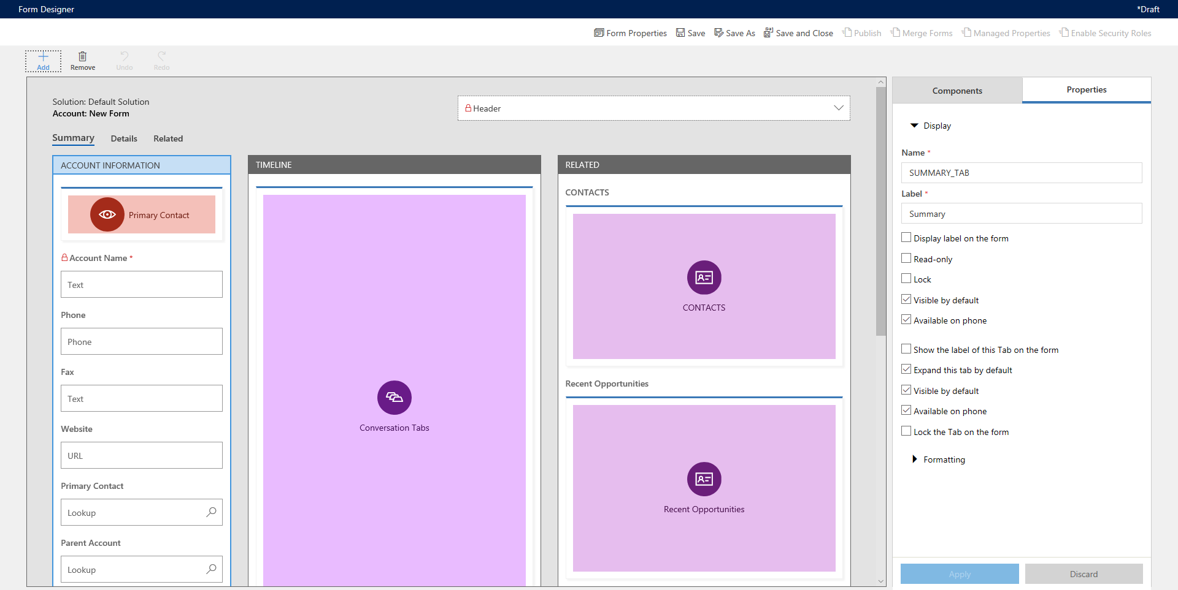
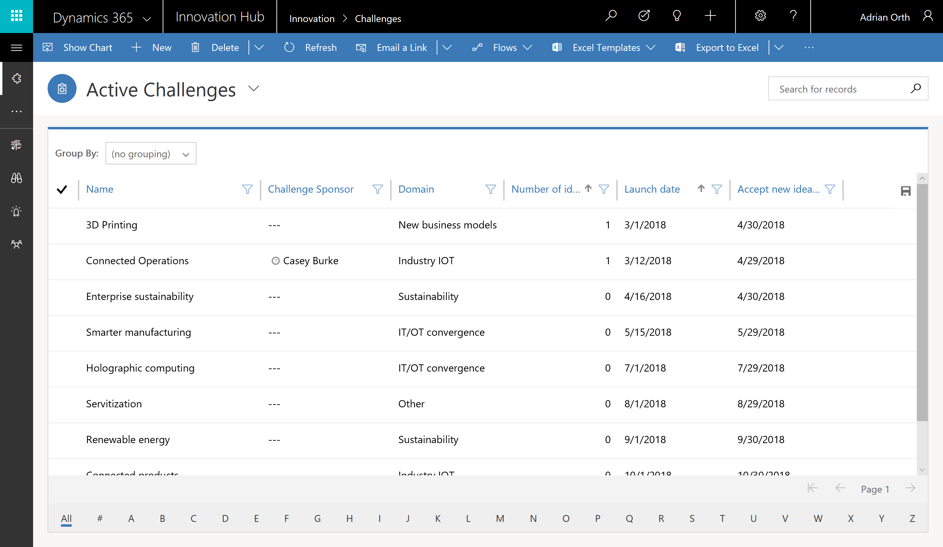
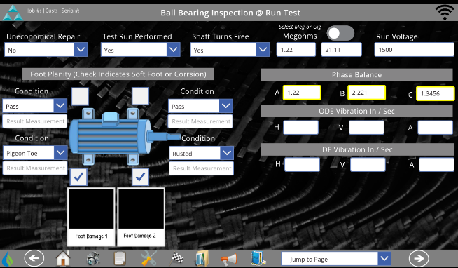
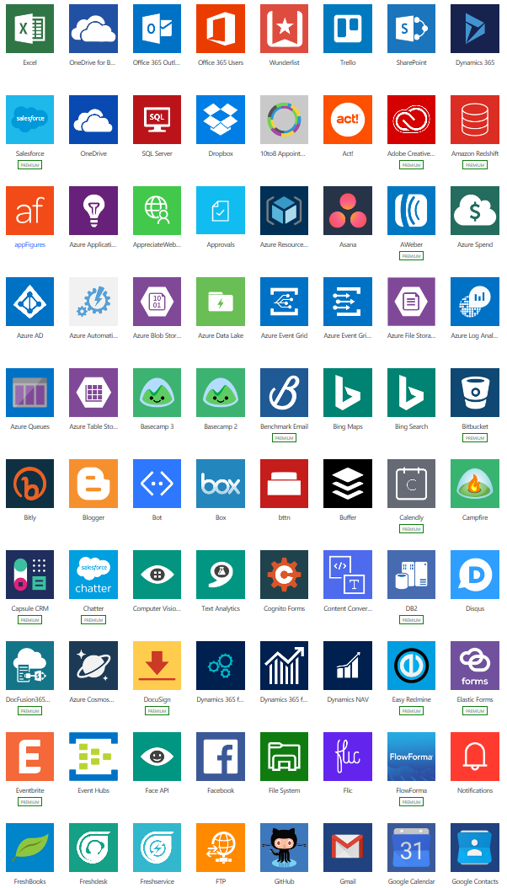
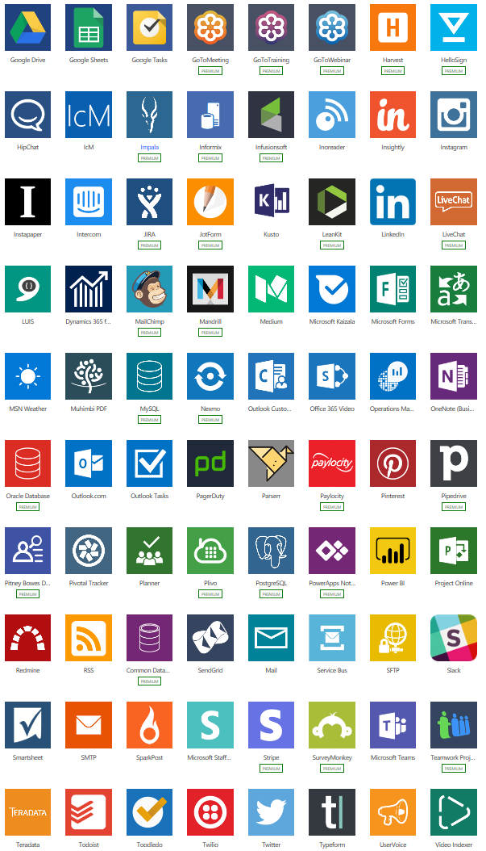
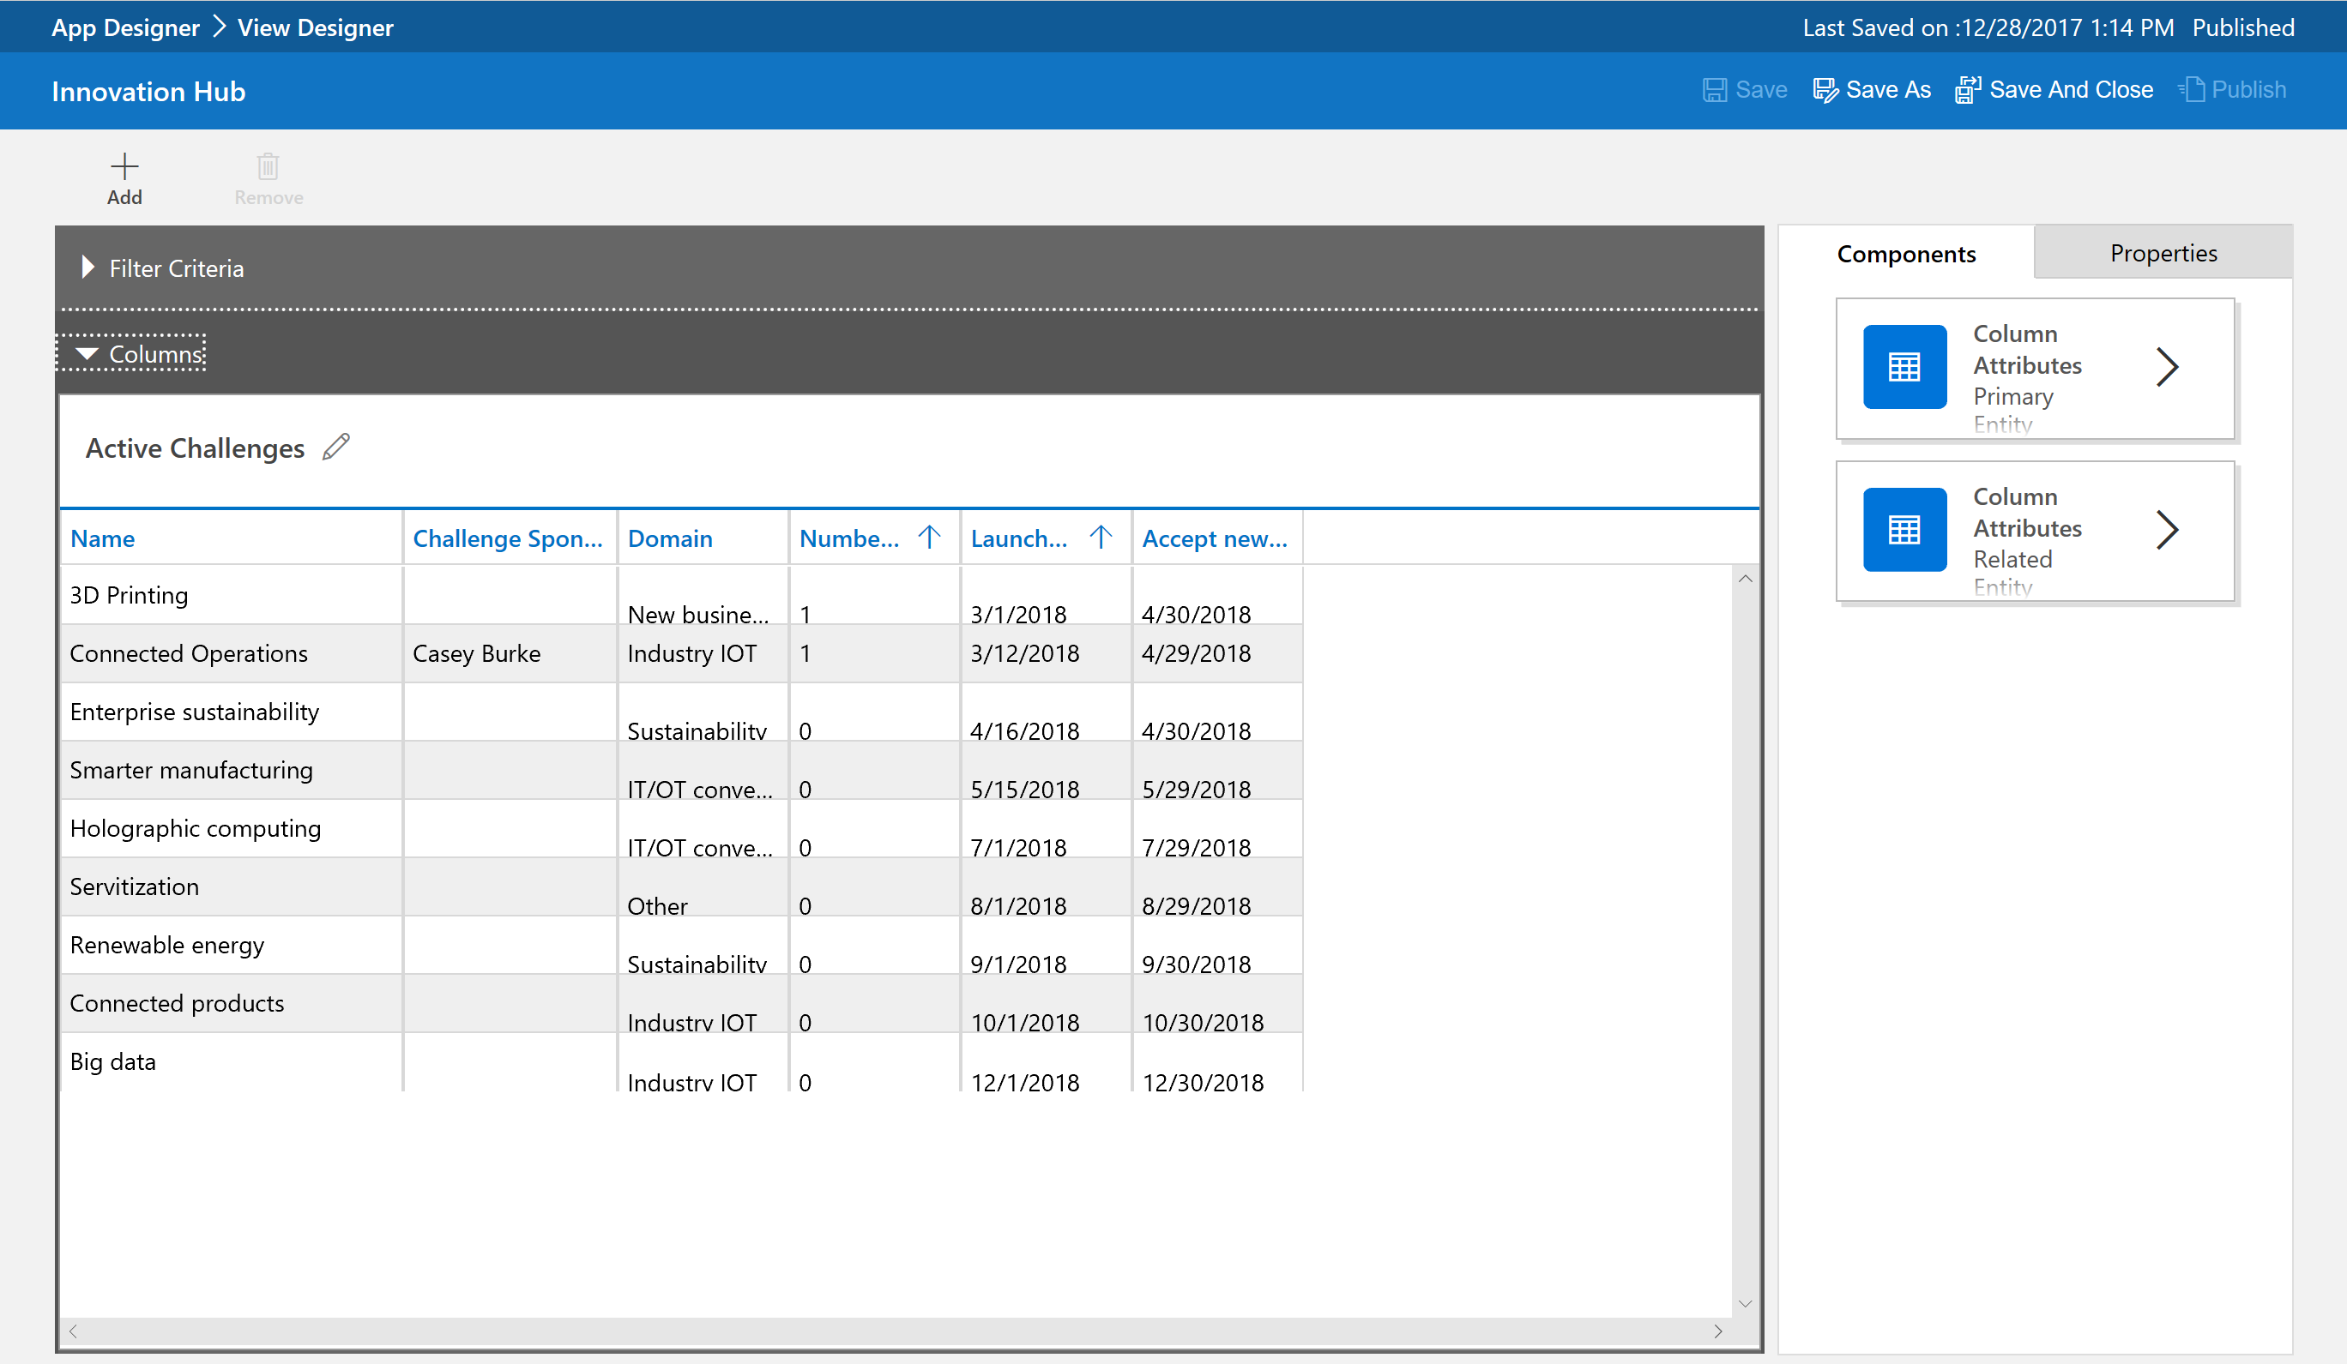
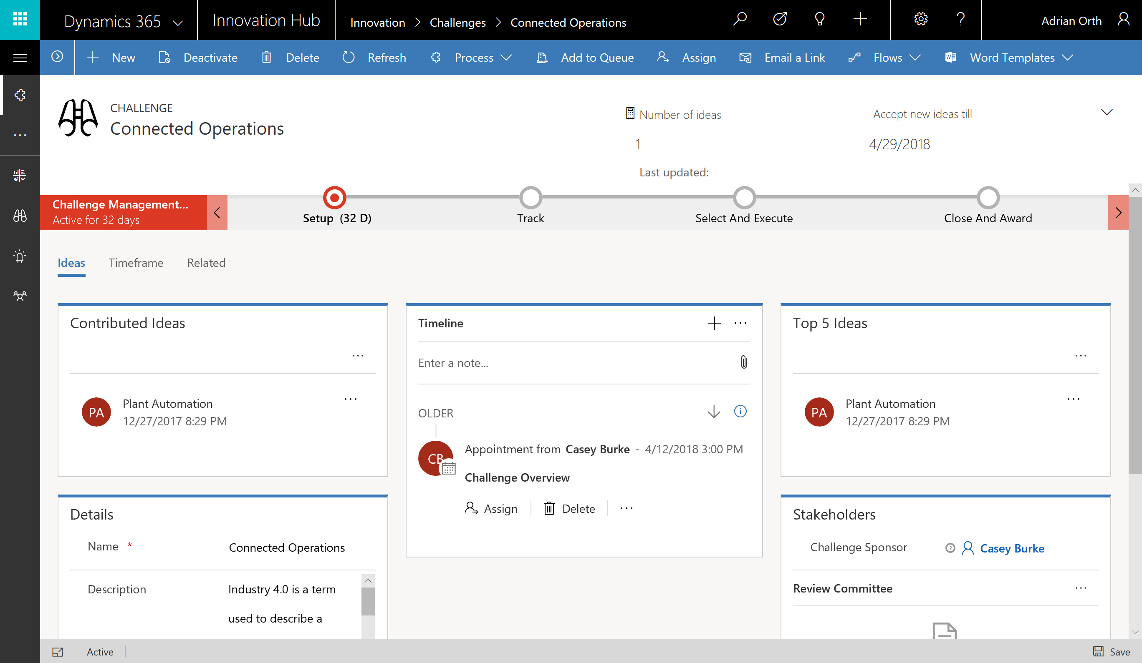
Focus on Canvas Apps
Canvas apps
Start with user experience designer
Task- and role-based apps
Mash up data from 200+ sources
Plan 1, PowerApps for Office
Model-driven apps
Built on the Common Data Service for Apps
Start with a data model, relationships, and business processes
Build End-to-End business applications
Plan 2

Slide 7
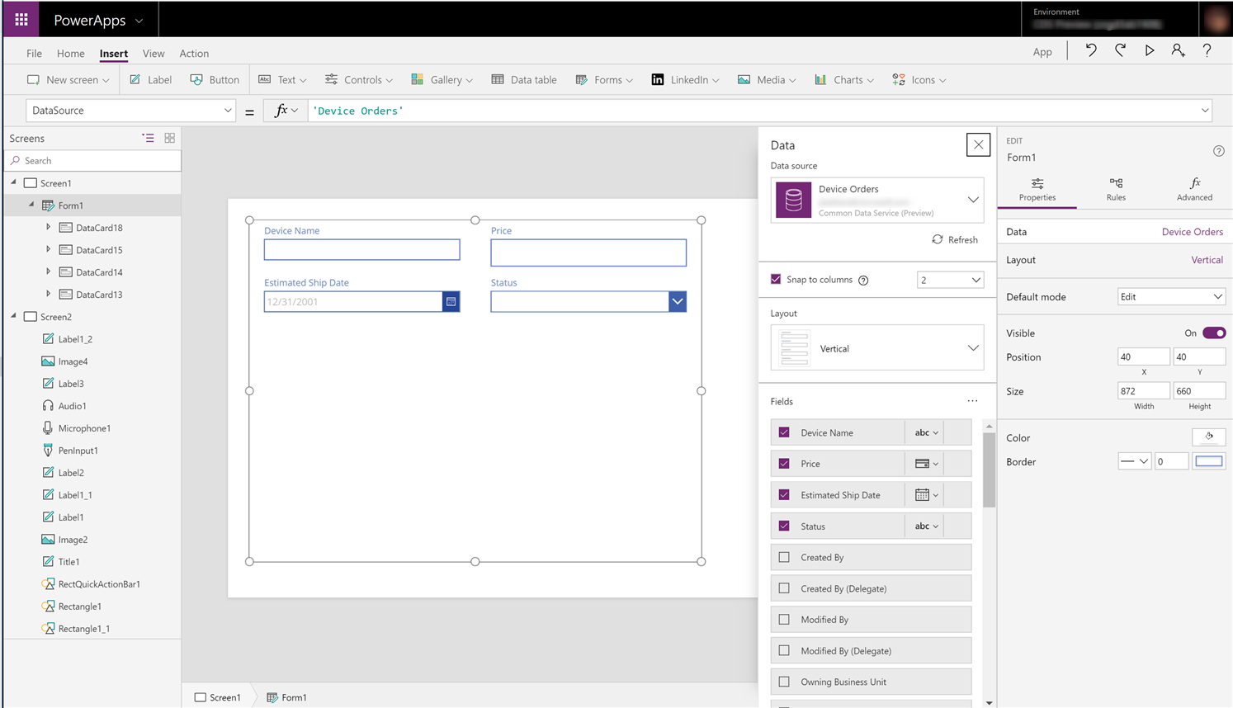
Easy Authoring
full control over user experience, use it as you build it
Create app logic with familiar Excel-like expressions
Mash up data from multiple sources right at the app level
Notes:
Volle Kontrolle über die Benutzererfahrung, verwenden Sie sie, wie Sie sie erstellen
Erstellen Sie App-Logik mit vertrauten Excel-ähnlichen Ausdrücken
Verknüpfen Sie Daten aus verschiedenen Quellen direkt auf der Anwendungsebene

Slide 8
Cloud and on-premises connectivity
Built-in connectivity to 200+ cloud services, files, databases, web APIs, etc.
Seamless hybrid connectivity to on-premises systems via the On-Premises Data Gateway
Build custom connectors for everyone to leverage
Enterprise-grade
Cloud and on-premises connectivity
Pro-developer extensibility

Slide 9
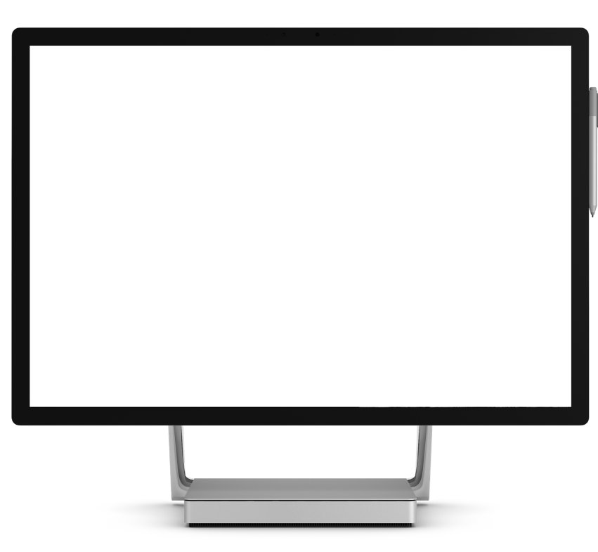
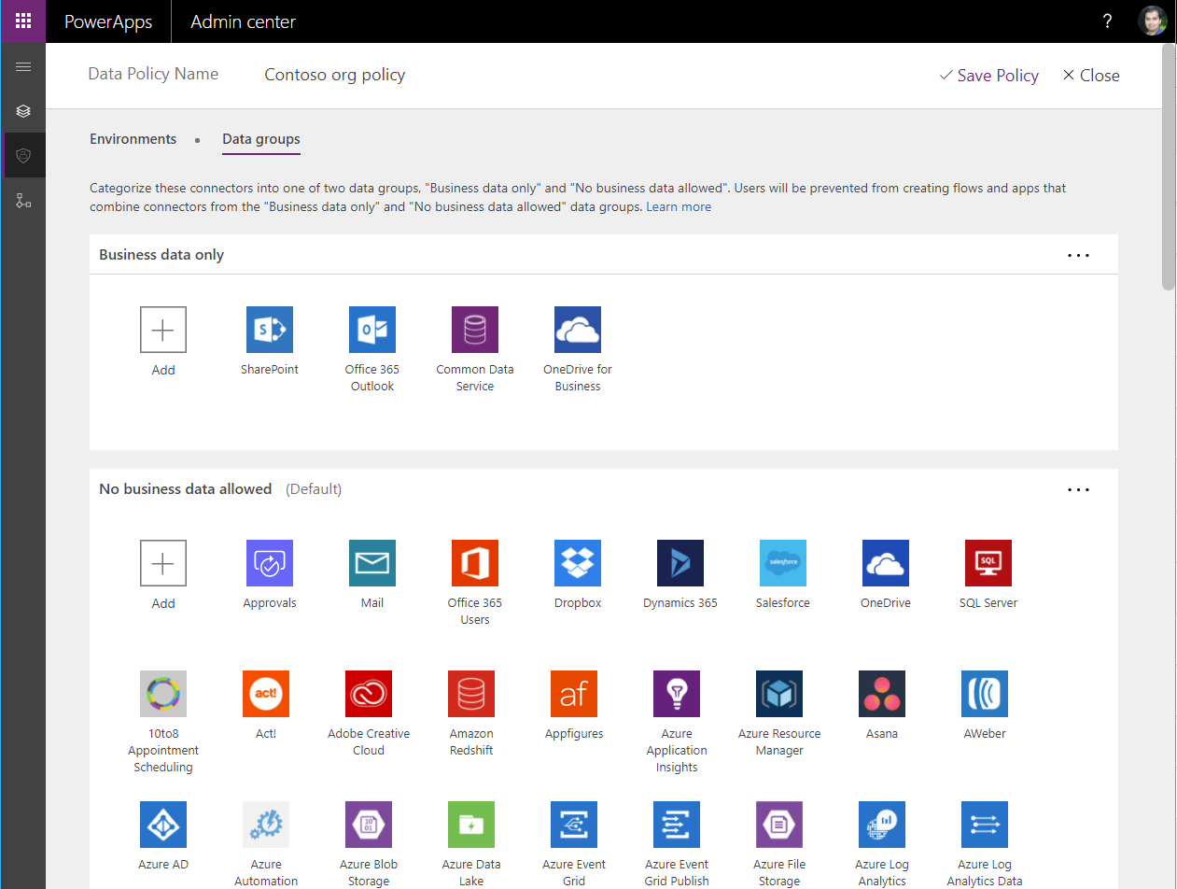
Enterprise-grade management and control
All identity is managed through Azure Active Directory, enabling rich policies and multi-factor authentication
Admin Center providing full audit logs, usage analytics, data loss prevention, security and data management
Centrally manage all your apps, first and third party, deployed across your organization
Enterprise-grade
Cloud and on-premises connectivity
Pro-developer extensibility
Notes:
Die gesamte Identität wird über Azure Active Directory verwaltet, was umfangreiche Richtlinien und eine mehrstufige Authentifizierung ermöglicht.
Admin Center mit vollständigen Prüfprotokollen, Nutzungsanalysen, Schutz vor Datenverlust, Sicherheit und Datenverwaltung
Zentrale Verwaltung aller in Ihrem Unternehmen eingesetzten Anwendungen, sowohl von Erstanbietern als auch von Drittanbietern

Slide 10
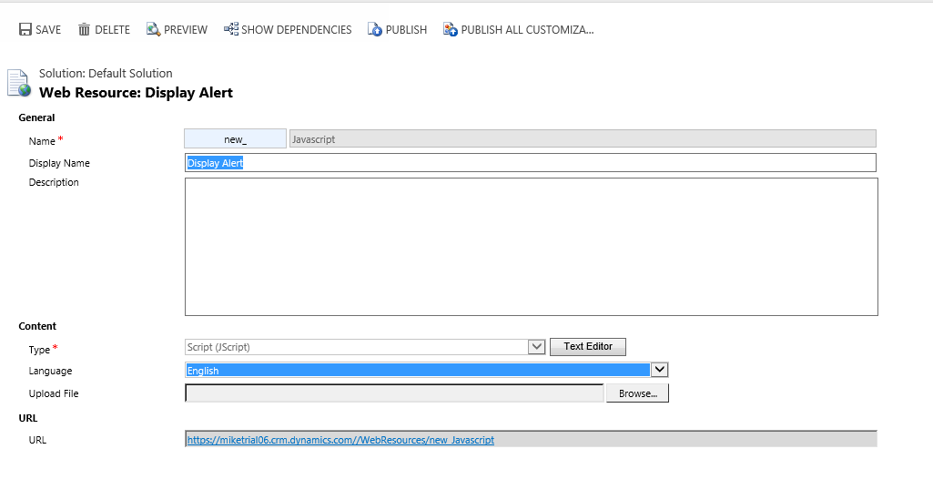
Amplify professional developer productivity
Extend applications using custom code
Build custom connectors that everyone can use
Write advanced client or server-side logic leveraging Azure Machine Learning, Cognitive Services, Bing APIs, custom code, or any service of your choice
Enterprise-grade
Cloud and on-premises connectivity
Pro-developer extensibility

Slide 11
Key Concepts

Slide 12
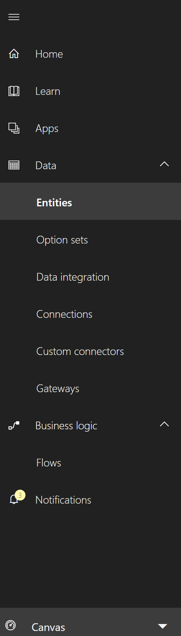
PowerApps Maker Portal [https://web.powerapps.com/]
Home page for Makers
Learn
Guided learning, documentation, community, what’s new
Manage Apps
View apps, open apps, create new apps, run sample apps, create apps from sample apps
Data
Manage Entities, option sets, data integration, connections, custom connections & gateways
Business Logic: Add Flows to your apps
Switch mode between Canvas and Model-driven

Slide 13
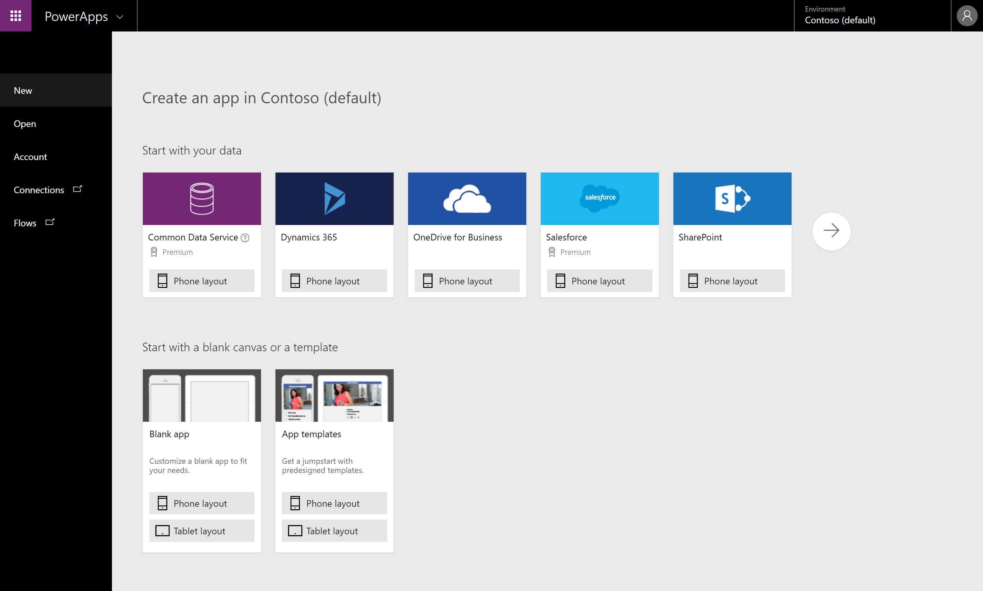
PowerApps Studio for the Web [https://create.powerapps.com/]
Canvas apps authoring experience
Start with your data
Start with a blank canvas
Start with a template

Slide 14
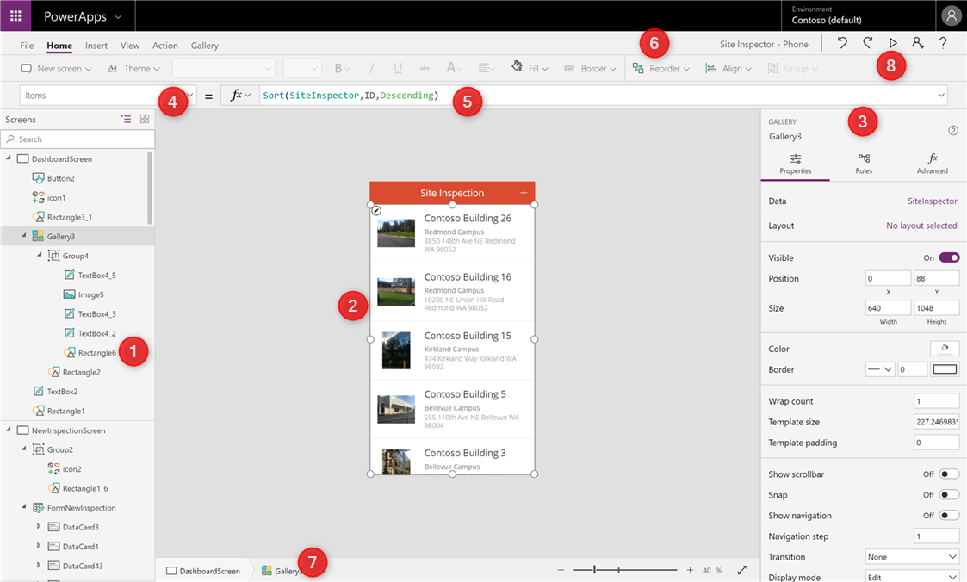
PowerApps Studio parts
Left Navigation bar
Middle pane (current screen)
Right-hand pane
Property drop-down list
Formula bar
Ribbon
Bread-crumb navigation
Preview button (F5)

Slide 15
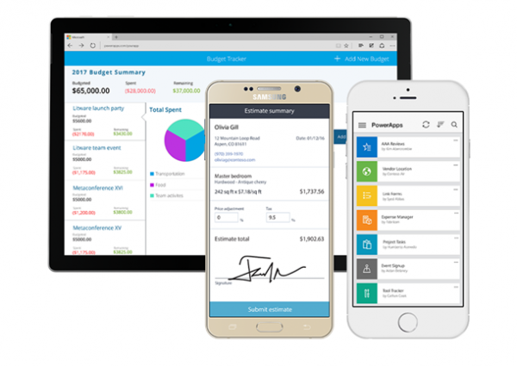



PowerApps Mobile (Player)
PowerApps Mobile for Windows, iOS, and Android
Available from respective app-stores as a free app
Sign-in using your work account (Office 365 /Azure AD credentials)
Access all your apps or apps shared with you across environments
Google Play: https://aka.ms/powerappsandroid
Apple App Store: https://aka.ms/powerappsios
Microsoft Store: https://aka.ms/powerappswin

Slide 16
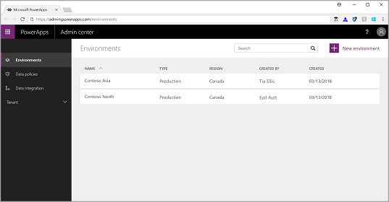
PowerApps Admin Center [https://admin.powerapps.com]
Administration of PowerApps, Microsoft Flow and Common Data Service for Apps
Create Environments & databases
Assign Data Loss Prevention policies
View active users in tenant
View apps and flows in environment or tenant

Slide 17
PowerApps Studio
Common Properties
UI: Controls
View: Data
UI-Data Binding: Properties & Formula bar

Slide 18
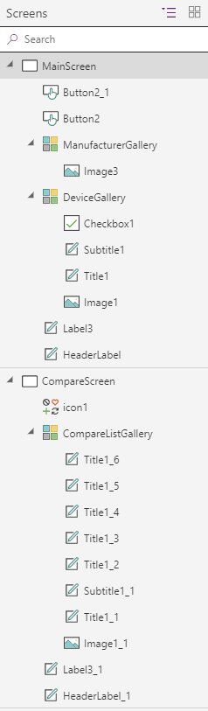
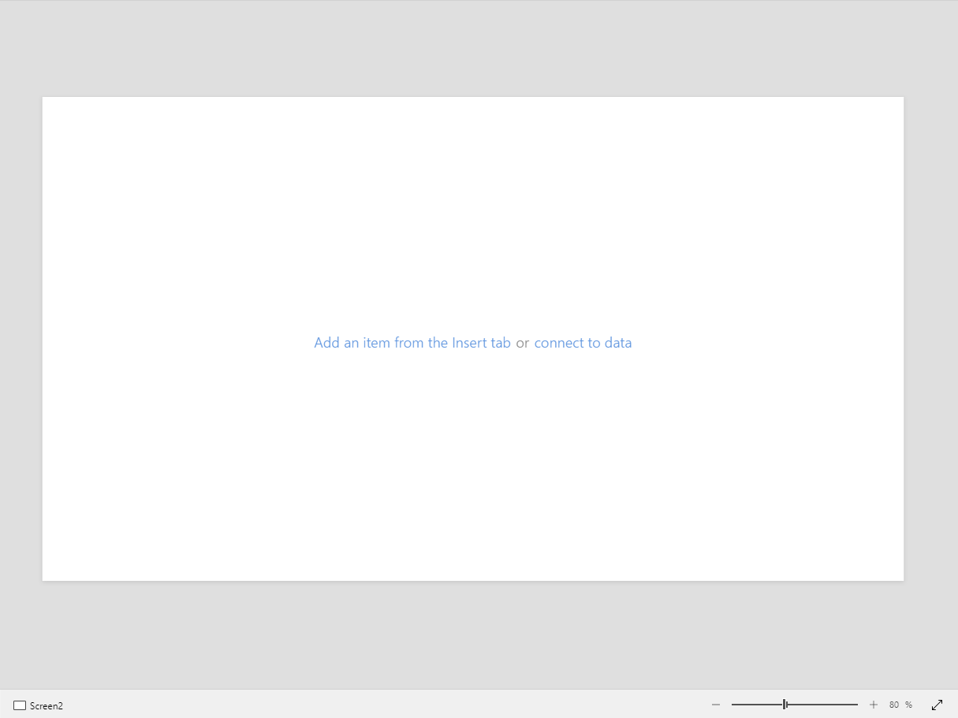
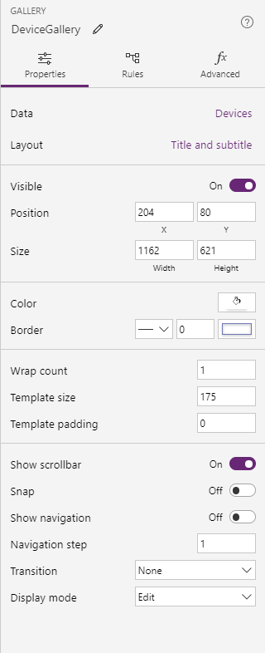
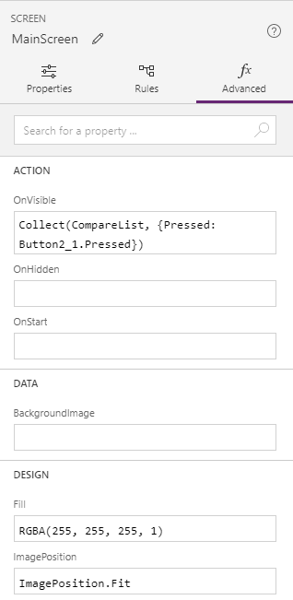
Screens & Controls View
Canvas
Properties Panel

Slide 19
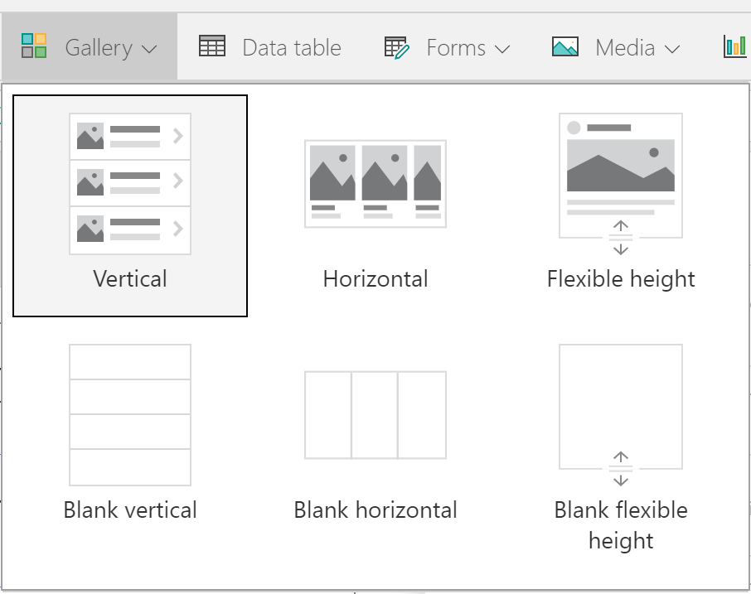
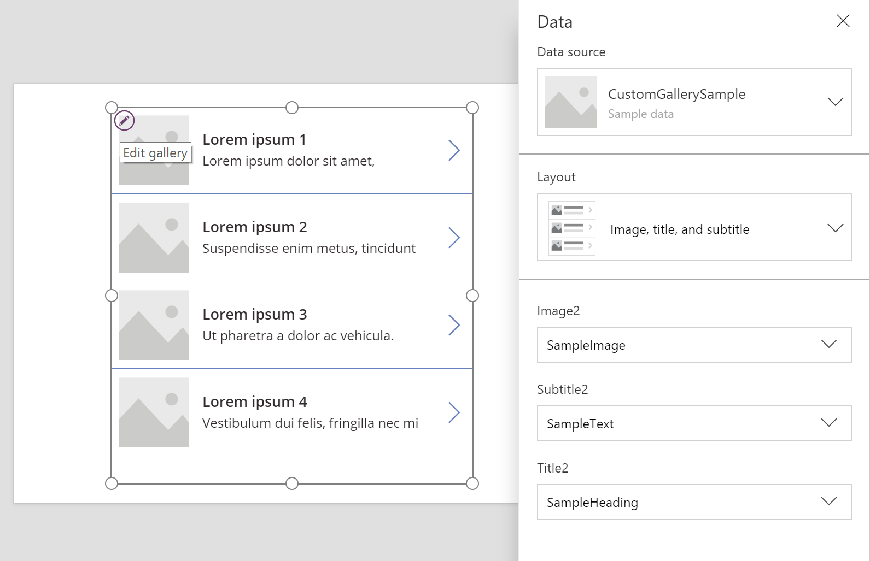
Gallery
First item is used to the edit the gallery template

Slide 20
Model-driven apps

Slide 21
Canvas apps start with user experience, with pixel-perfect control to build highly customized task- and role-based apps that mash up data from 190+ sources
Model-driven apps leverage your data model, relationships, and business processes to automatically generate immersive, responsive applications
Notes:
Modellgesteuertes App-Design ist ein Ansatz, der sich auf das Hinzufügen von Komponenten wie Formulare, Ansichten, und Diagramme und Dashboards zu Tabellen mit einem App-Designer-Tool. Zusätzlich verbinden Beziehungen Tabellen so, dass die Navigation zwischen ihnen möglich ist und Daten nicht unnötig wiederholt werden.
Mit App-Designer können Sie mit keinem oder nur sehr wenig Code Apps erstellen, die einfach oder sehr komplex sind.

Slide 22

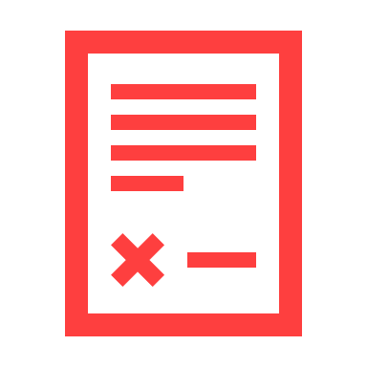

PowerApps Model-driven apps provides a metadata-driven architecture for creating and customizing apps without writing code
Rich component-focused no-code design environments
Easily add Business rules and Business process flows to model your business processes
Complex responsive apps on web and mobile

Slide 23
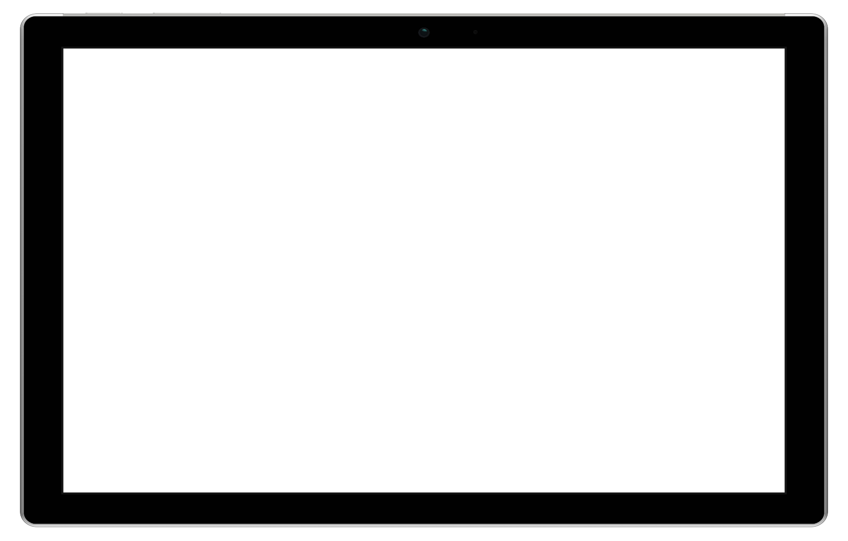
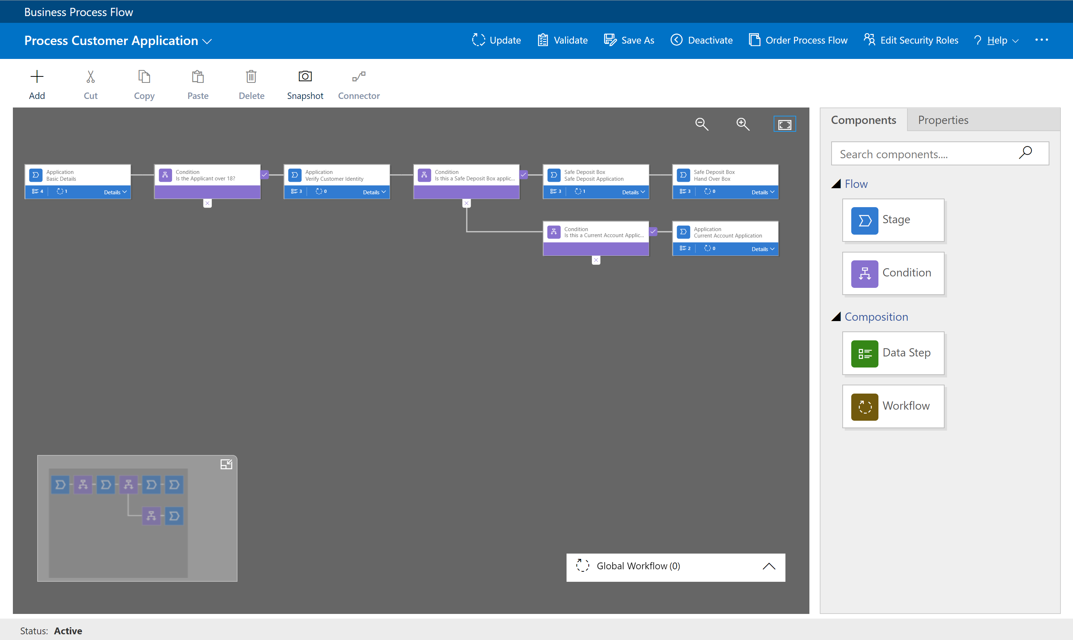
Business Process Flow
Visual indicators that tell users where they are in the business process
Reduce the need for training
Configurable to support common line of business methodologies

Slide 24
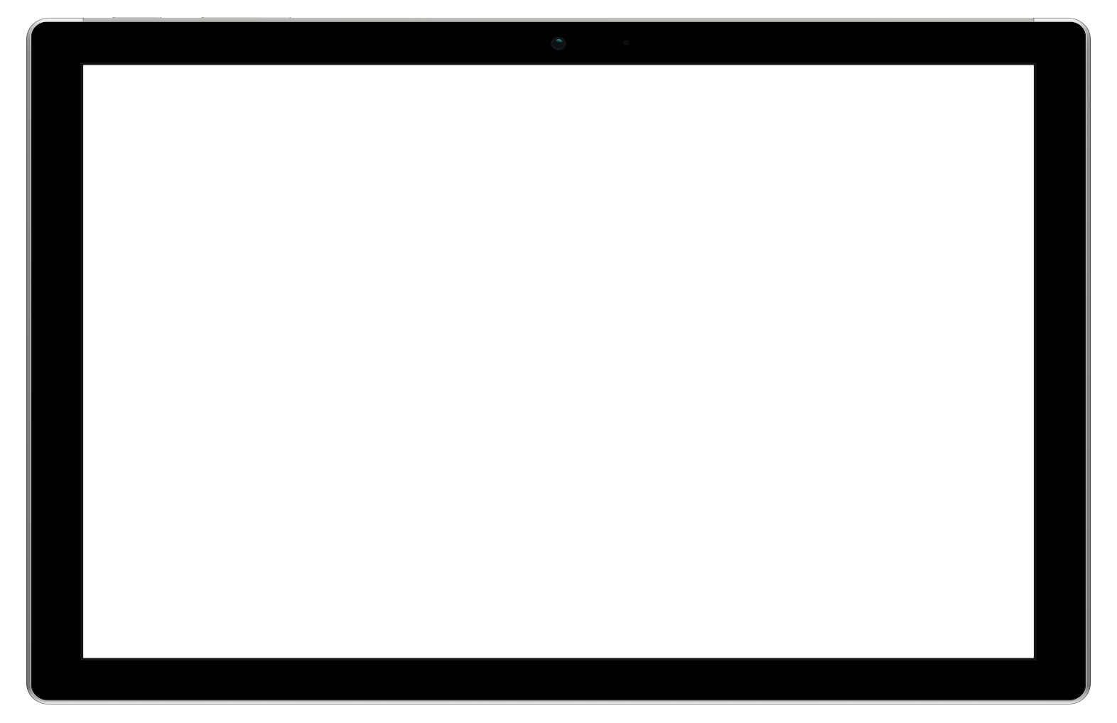
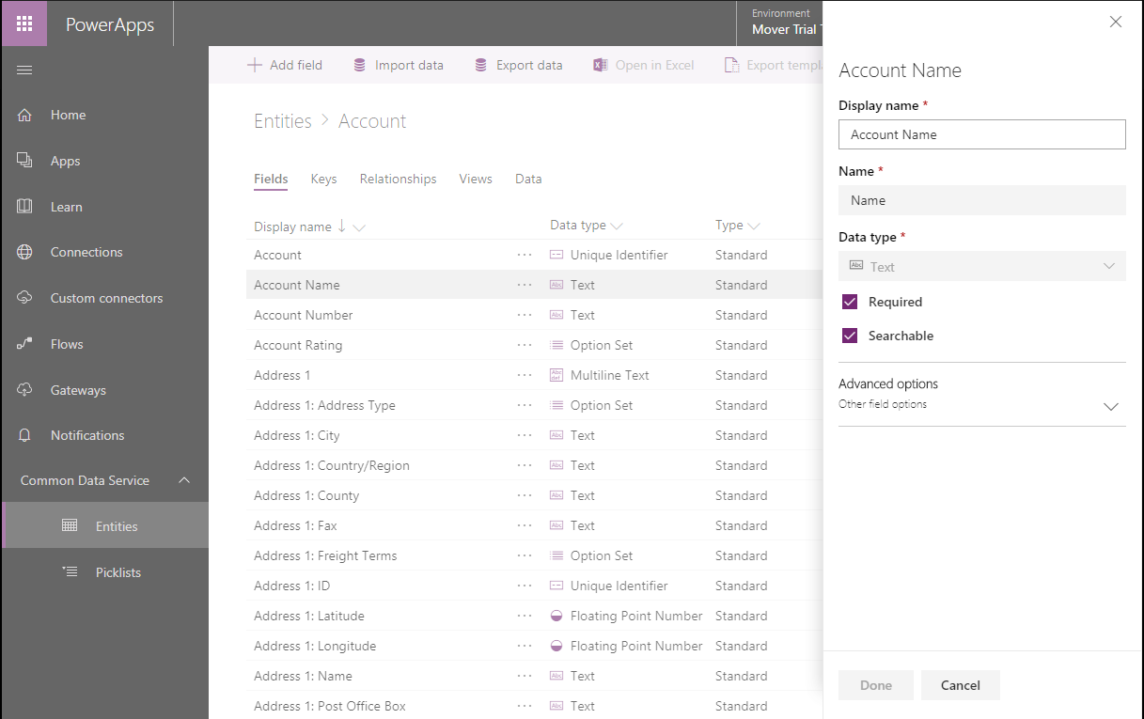
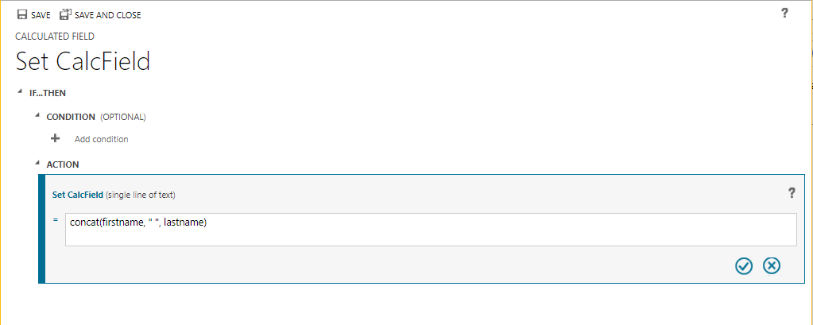
Server Side Logic
Server-side logic bound to entities, works across all apps
Create calculated and roll up fields
Easily create validation and set field defaults
Update related entities with synchronous workflows

Slide 25
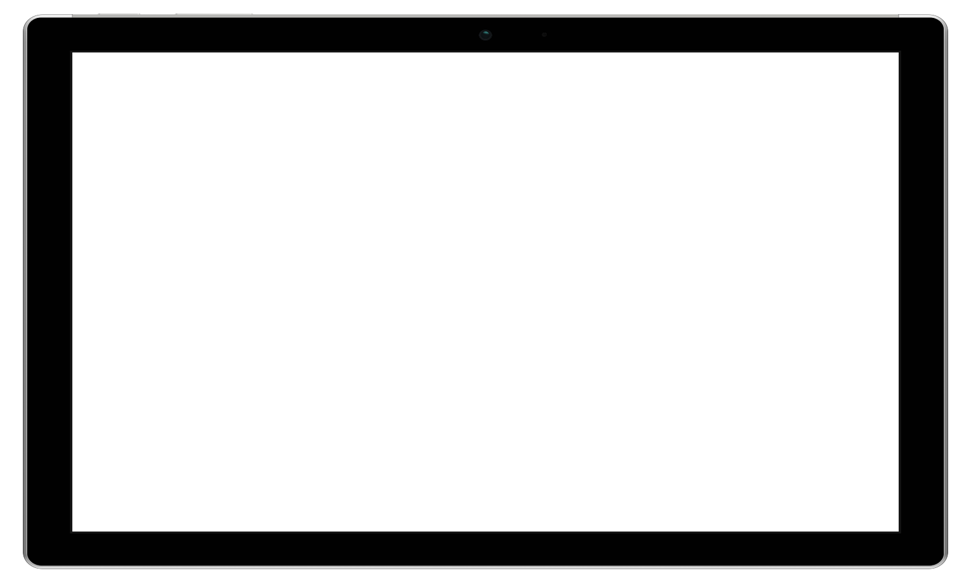
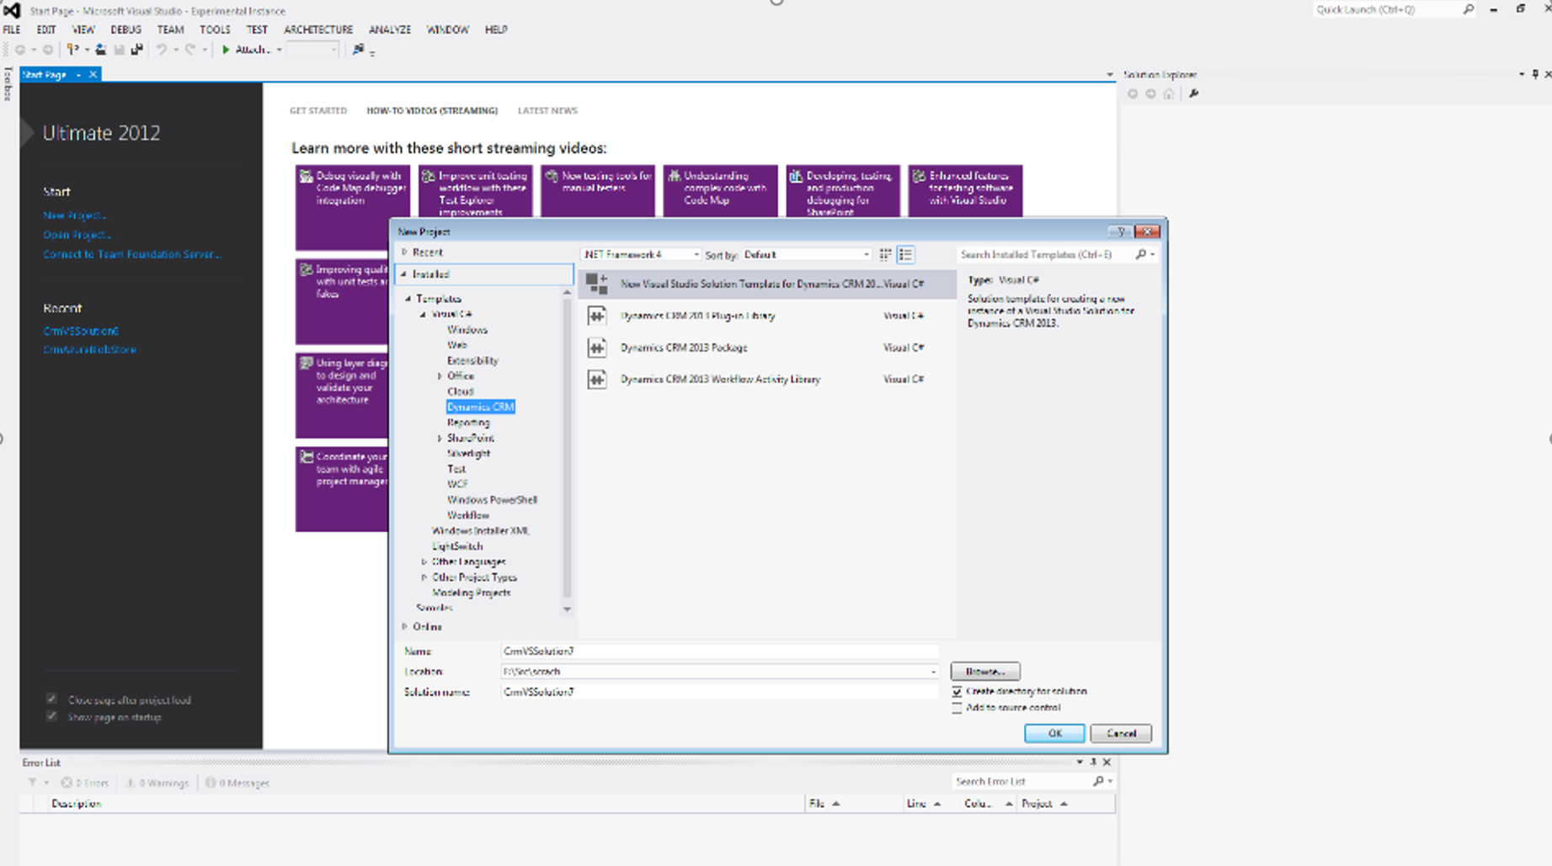
Developer Capabilities
Robust solution framework for application install and updates
Visual Studio integrated developer toolkit
Odata web API
.Net SDK
Sandbox instances for ALM operations

Slide 26
Canvas apps and Model-driven apps are complementary to each other
Canvas Apps | Model Driven Apps
Start with the User Experience or Data | Start with the Data Model (schema)
Build visually appealing, pixel-perfect apps | Component-driven approach to app building
Use concepts like screens, controls, formulae, connections | Use components like site maps, entities, forms, views, charts, dashboards, business process flows
Separate mobile and tablet app creation experiences | Responsive web & mobile apps out of the box
Create mash-up apps using data from multiple data sources using the 200+ connectors or custom connectors | Create apps using entities and virtual-entities in CDS for Apps
Use any PowerApps license (Office 365/P1-P2 or Dynamics 365) | Only PowerApps Plan 2 or Dynamics 365 Enterprise license
Great for building task-focused apps for a specific personas | Great for back-office scenarios involving complex business processes
Security and access for the data is managed on the data-source chosen | Add role-based security and row-level security to your data
Use entities stored in CDS for Apps through CDS connector (P1/P2 required) | Use Business Process Flows, code add-ins & real-time workflows

Slide 27
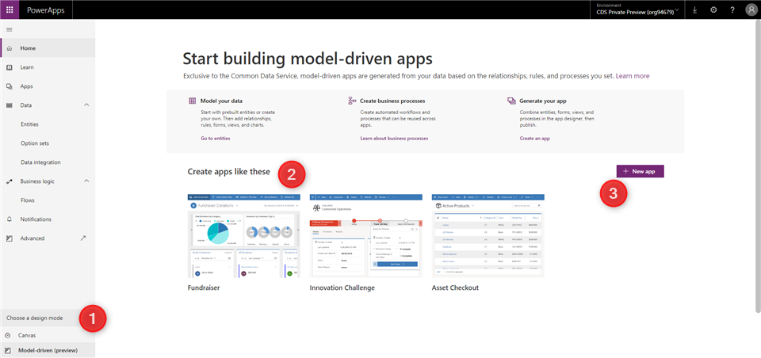
PowerApps Maker Portal [https://web.powerapps.com/]
Switch design mode to Model-driven
Explore sample apps
Create new Model-driven apps

Slide 28
Model-driven app components - Data
Component | Description | Designer
Entity | An item with properties that you track, such as a contact or account. Many standard entities are available. You can customize a non-system standard entity (production entity) or create a custom entity from scratch. | PowerApps entity designer
Field | A property that is associated with an entity. A field is defined by a data type, which determines the type of data that can be entered or selected. Examples include text, number, date and time, currency, or lookup (creates a relationship with another entity). Fields typically are used with forms, views, and searches. | PowerApps entity designer
Relationship | Entity relationships define how entities can be related to each other. There are 1:N (one-to-many), N:1 (many-to-one), and N:N (many-to-many) types of relationships . For example, adding a lookup field to an entity creates a new 1:N relationship between the two entities and lets you put that lookup field on a form. | PowerApps entity designer
Option set field | This is a special type of field, which provides the user a set of predetermined options. Each option has a number value and label. When added to a form, this field displays a control for the user to select an option. There are two kinds of option sets; option sets, where the user can only select one option, and multi-select options sets, which allow more than one selection. | PowerApps option set designer
Notes:
Entity - Ein Element mit Eigenschaften, die Sie verfolgen, z. B. ein Kontakt oder ein Konto. Es sind viele Standardentitäten verfügbar. Sie können eine systemfremde Standardentität (Produktionsentität) anpassen oder eine benutzerdefinierte Entität von Grund auf erstellen.
Field - Eine Eigenschaft, die mit einer Entität verbunden ist
Relationship - definieren, wie Entitäten zueinander in Beziehung gesetzt werden können.

Slide 29
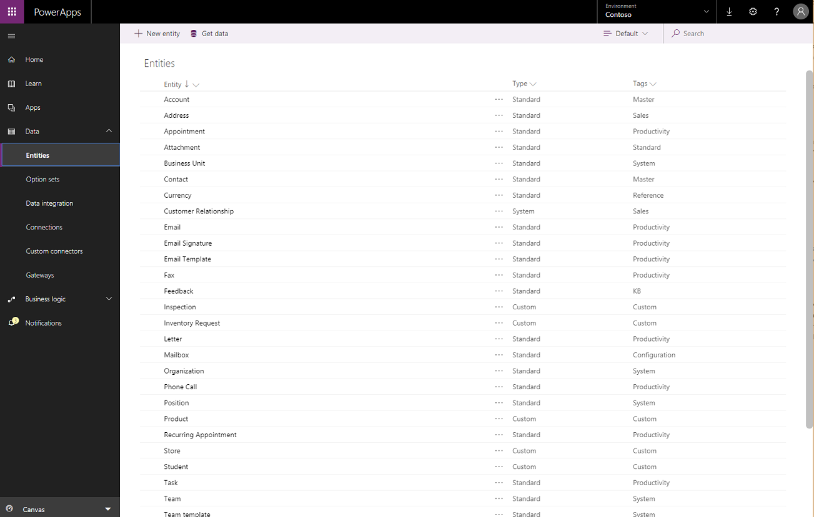
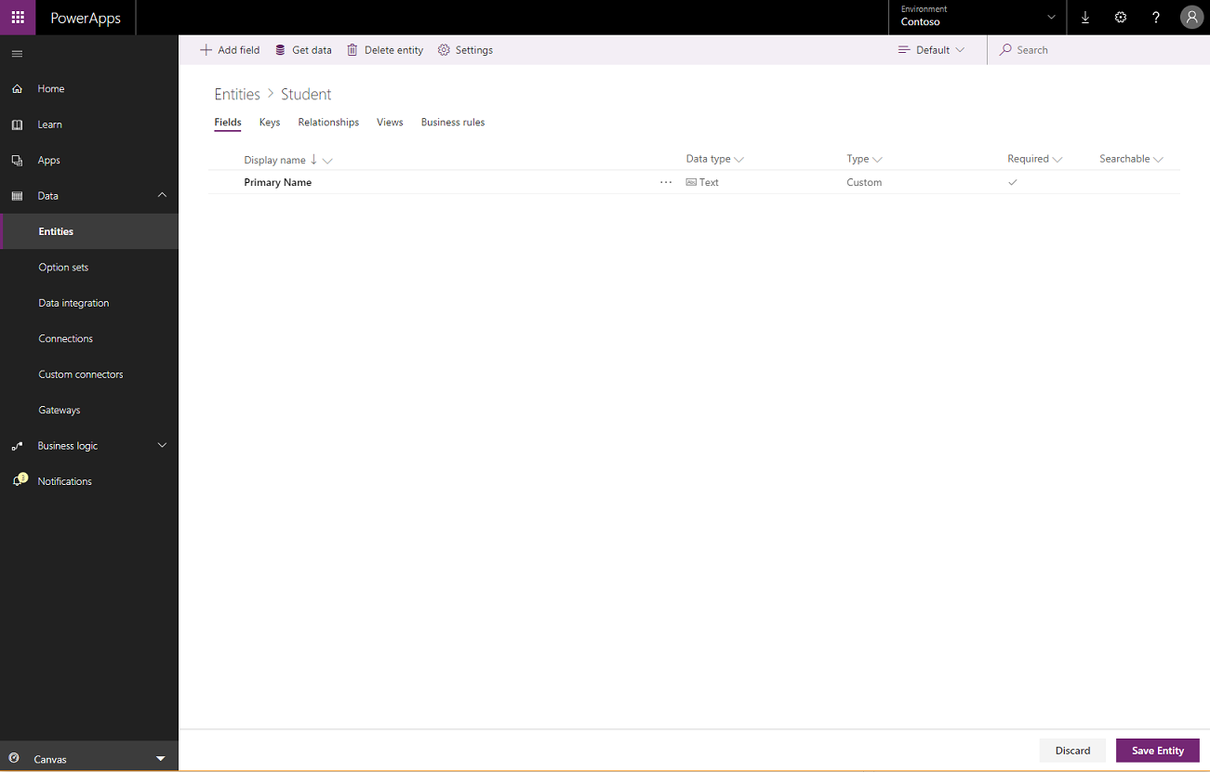
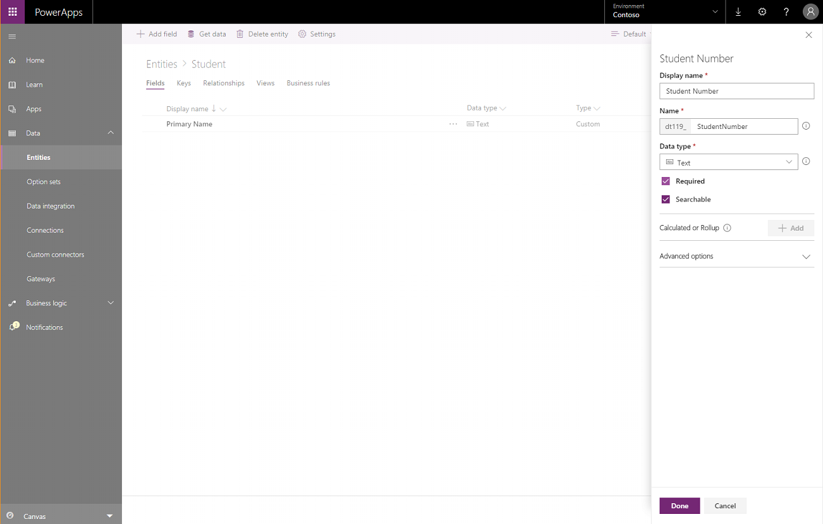

Slide 30
Model-driven app components - UI
Component | Description | Designer
App | Determines the application fundamentals such as components, properties, client type, and URL for your app. | App designer
Site map | Specifies the navigation for your app. | Site map designer
Form | A set of data-entry fields for a given entity that matches the items that your organization tracks for the entity. For example, a set of data-entry fields that where user’s input relevant information to track a customer’s previous orders along with specific requested reorder dates. | Form designer
View | Views define how a list of records for a specific entity is displayed in your application. A view defines the columns to display, width of each column, sort behavior, and the default filters. | View designer

Slide 31
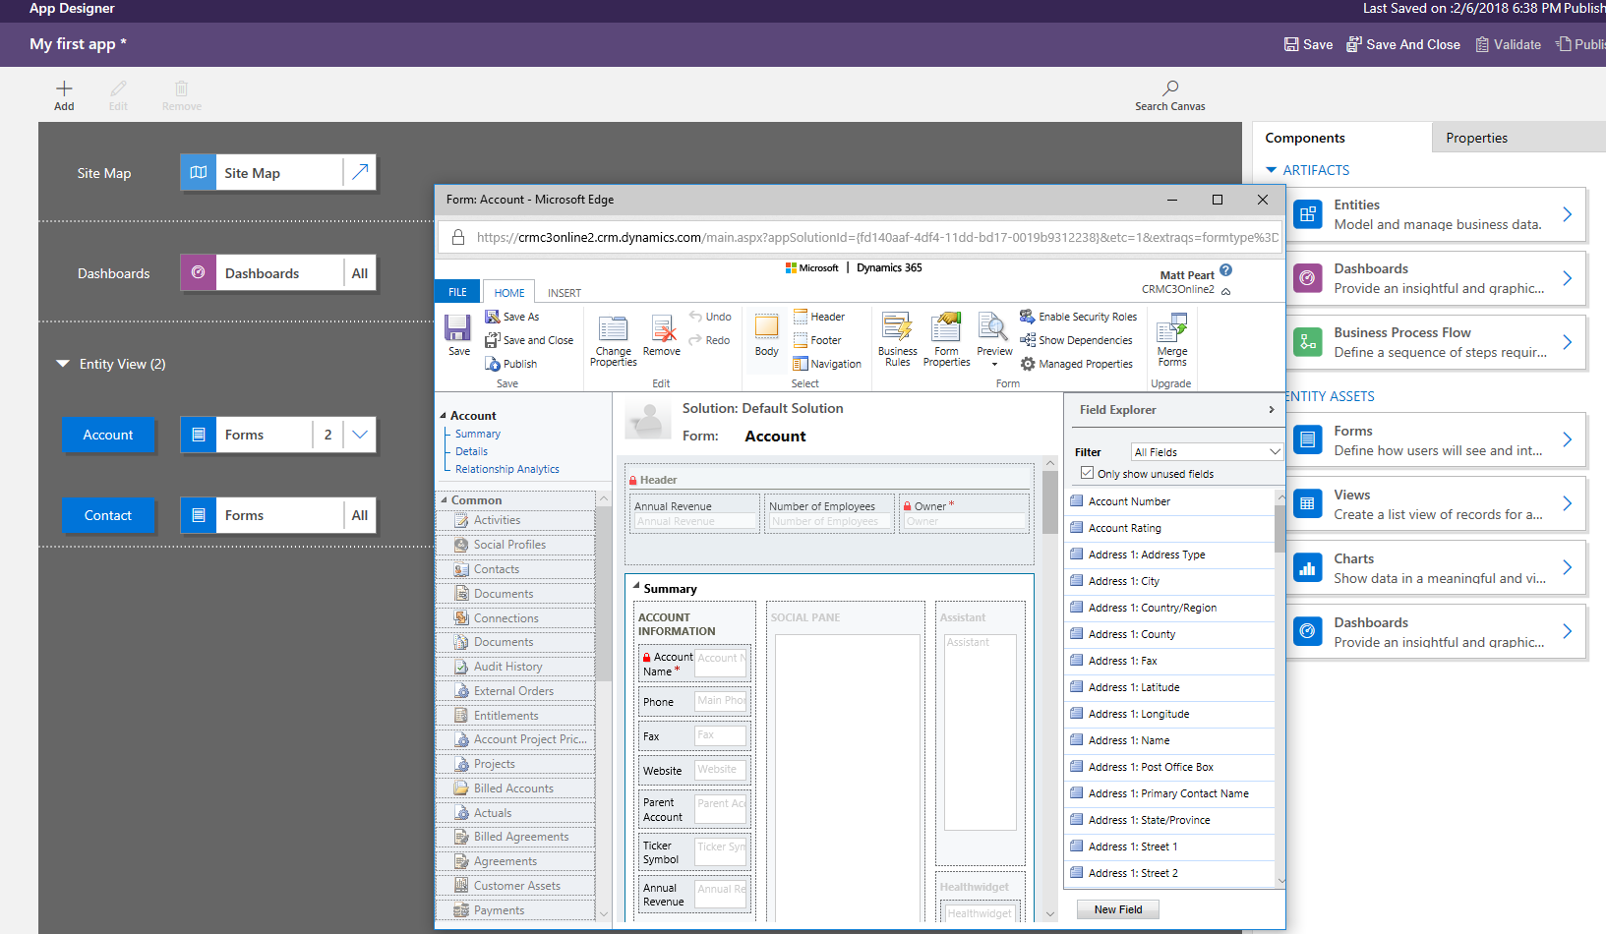

Slide 32
Model-driven app components - Logic
Type of logic | Description | Designer
Business process flow | An online process that walks users through a standard business process. For example, use a business process flow if you want everyone to handle customer service requests the same way, or to require staff to gain approval for an invoice before submitting an order. | Business process flow designer
Workflow | Workflows automate business processes without a user interface. Designers use workflows to initiate automation that doesn’t require any user interaction. | Workflow designer
Actions | Actions are a type of process that let you manually invoke actions, including custom actions, directly from a workflow. | Process designer
Business rule | Used to apply rule or recommendation logic to a form, such as to set field requirements, hide fields, or validate data. App designers use a simple interface to implement and maintain fast-changing and commonly used rules. | Business rule designer
Flow | Flow is a cloud-based service that lets you create automated workflows between apps and services to get notifications, synchronize files, collect data, and more. | Microsoft Flow

Slide 33
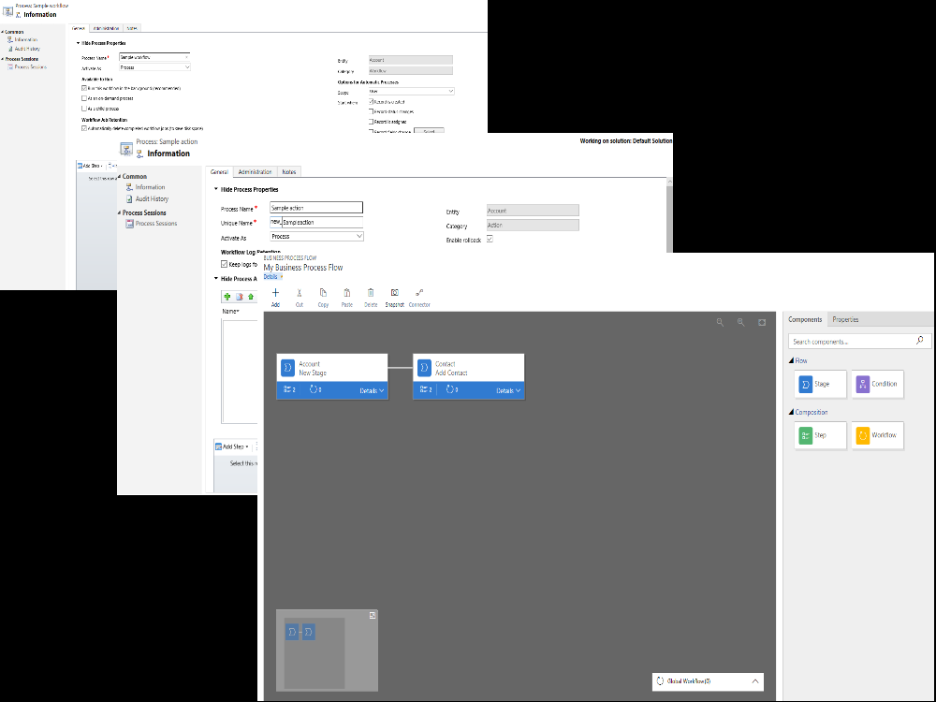

Slide 34
Model-driven app components - Visualizations
Component | Description | Designer
Chart | A single graphic visualization that can be displayed within a view, on a form, or be added to a dashboard. | Chart designer
Dashboard | Functions as a palate for one or more graphic visualizations that provide an overview of actionable business data. | Dashboard designer
Embedded Power BI | Add embedded Power BI tiles and dashboards to your app. Power BI is a cloud-based service that provides business intelligence insight. | Combination of chart designer, dashboard designer, and Power BI

Slide 35
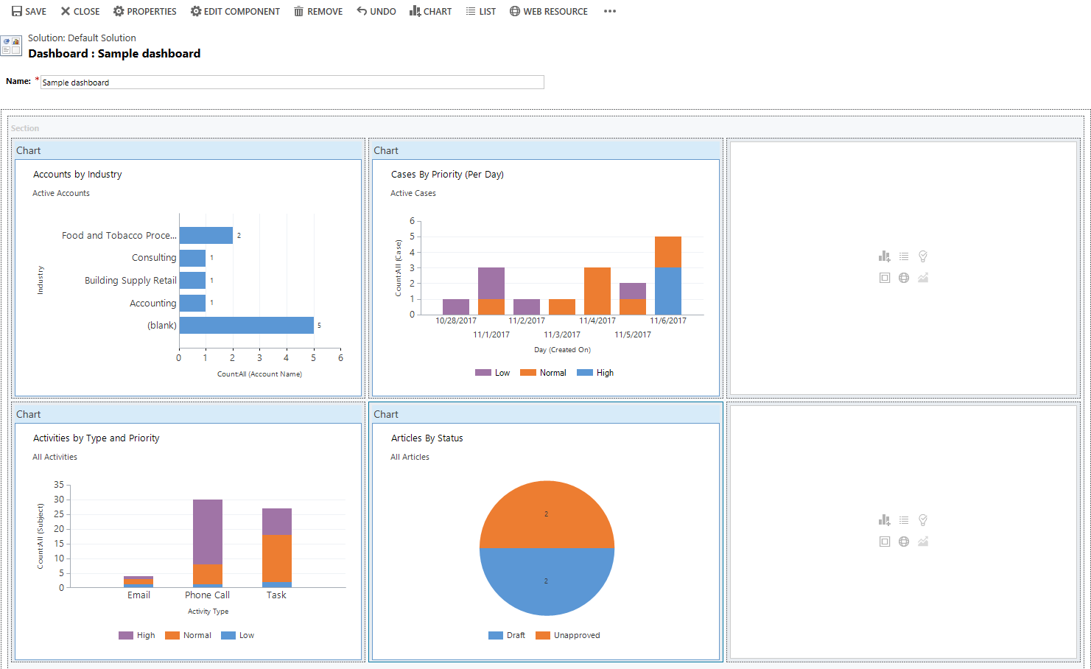

Slide 36
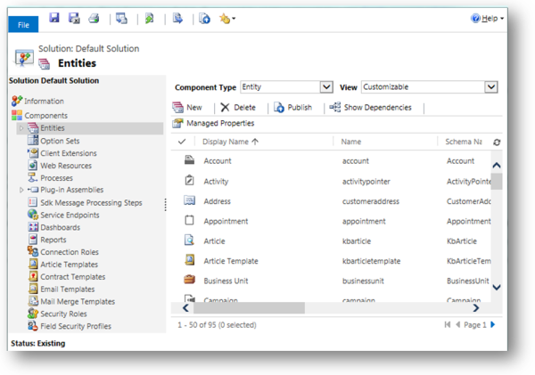
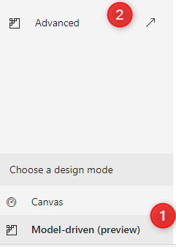
Advanced Model-driven app making
To open solution explorer, select Model-driven on the left pane of PowerApps
Then select the Advanced tab.

Slide 37
Demo
Task Manager

Slide 38
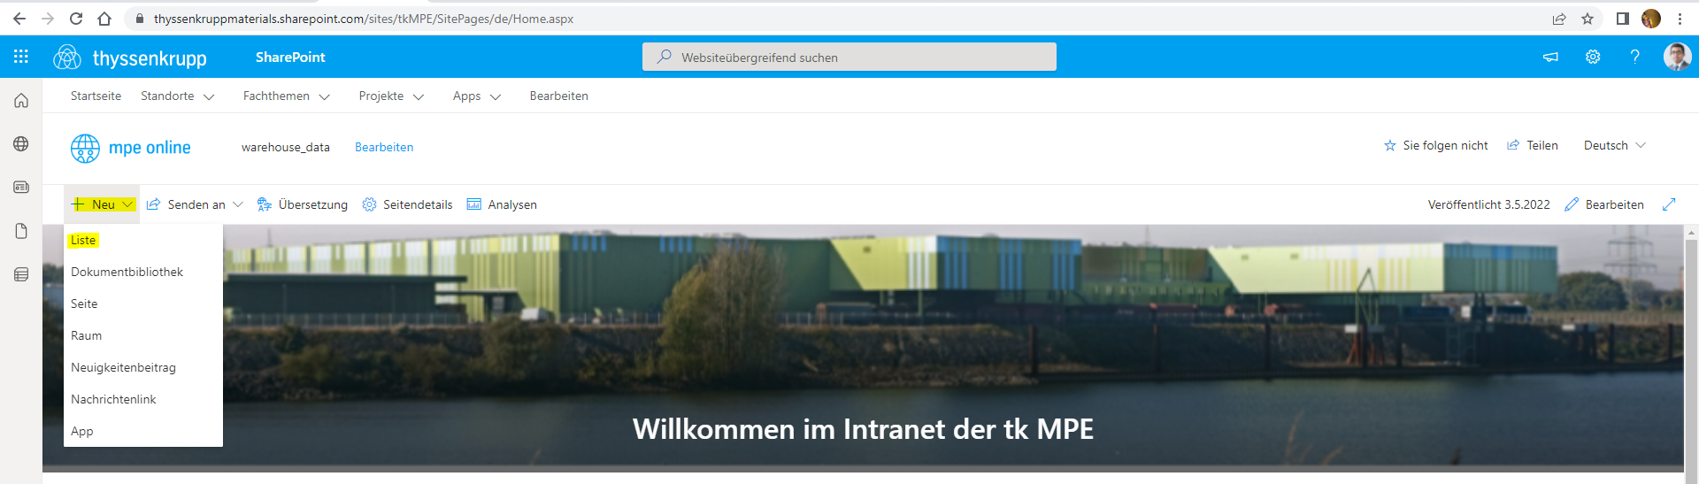

Slide 39
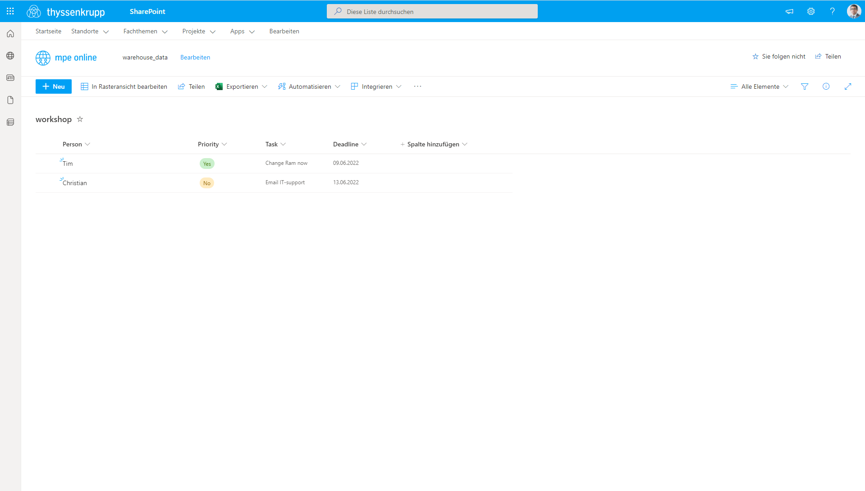
https://thyssenkruppmaterials.sharepoint.com/sites/tkMPE/Lists/workshop/AllItems.aspx

Slide 40
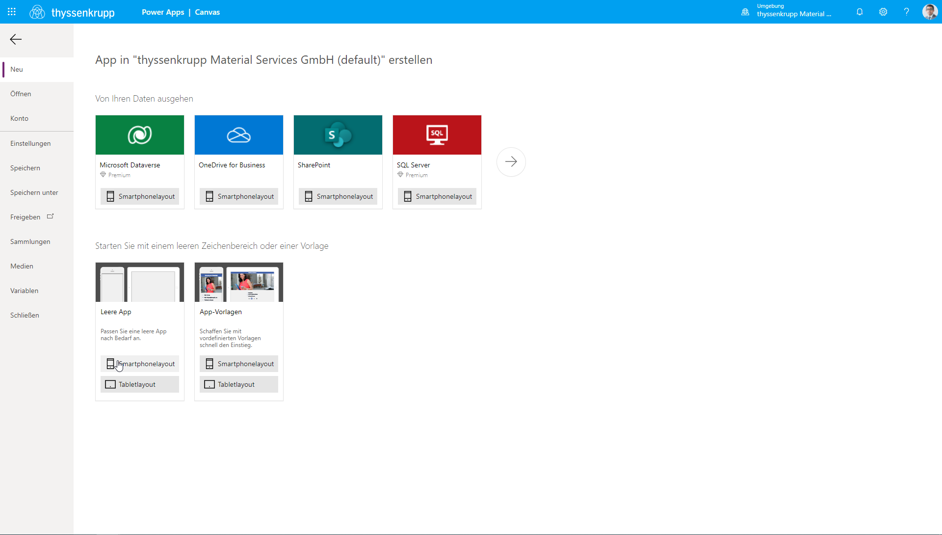

Slide 41
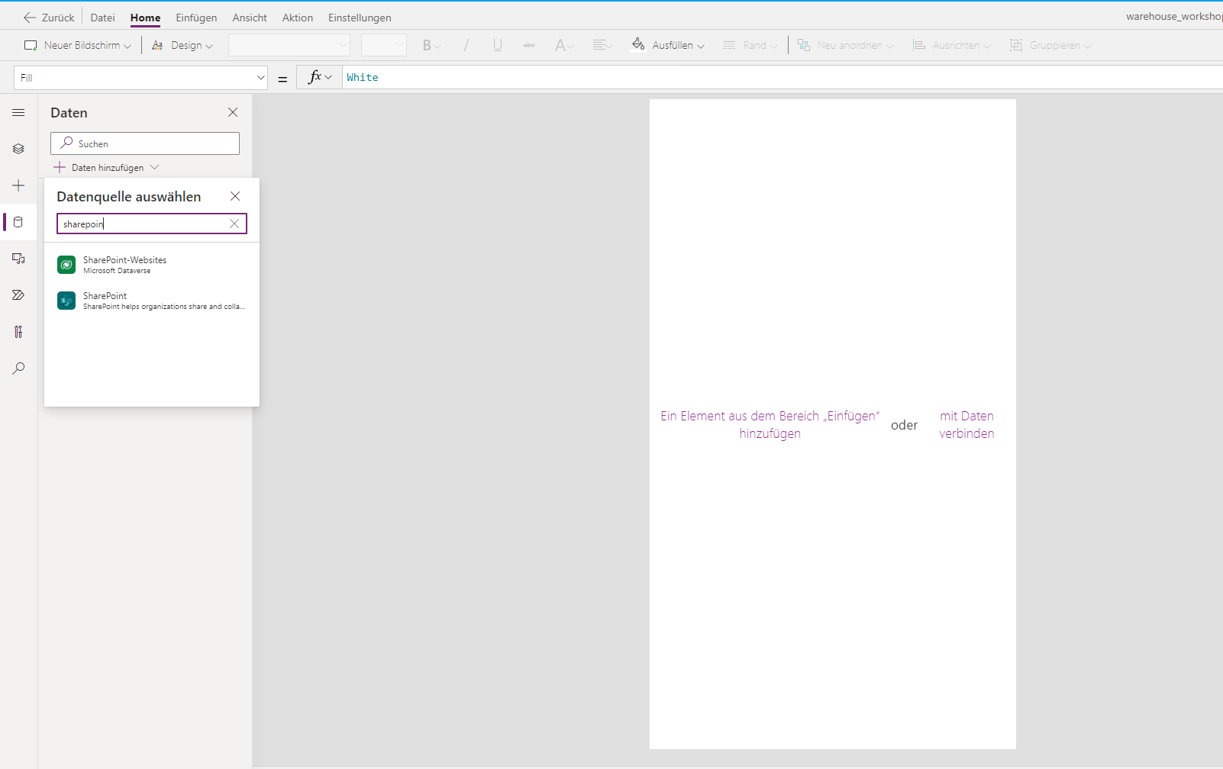

Slide 42


Slide 43


Slide 44


Slide 45


Slide 46


Slide 47


Slide 48


Slide 49


Slide 50


Slide 51


Slide 52


Slide 53


Slide 54


Slide 55


Slide 56


Slide 57


Slide 58


Slide 59


Slide 60


Slide 61


Slide 62


Slide 63


Slide 64


Slide 65


Slide 66


Slide 67


Slide 68
Demo
Importing Powerapp

Slide 69


Slide 70


